Slide 1
(v1.3 – March 2019)
Speaker:
Microsoft field technical sellers, Microsoft Data Platform Partners, Microsoft Data Platform MVPs.
Audience:
Microsoft Customers & Partners
Desired outcomes:
This presentation is in support of Azure SQL Database
Objectives for this presentation are for the audience to gain a detailed understanding of:
Azure SQL Database Managed Instance
Th architecture and design consideration deploying to the cloud with Azure SQL Managed Instance
Deck Usage:
This is a Microsoft presentation intended for Microsoft FTEs, Partner and Customers to better understand Azure SQL Database Managed Instance.
The deck should be part of a an overall workshop session including labs & demos led by a subject matter expert on Microsoft SQL Server and/or Azure SQL Database
(c) 2019 Microsoft Corporation. All rights reserved. This document is provided "as-is." Information and views expressed in this document, including URL and other Internet Web site references, may change without notice. You bear the risk of using it. This document does not provide you with any legal rights to any intellectual property in any Microsoft product. You may copy and use this document for your internal, reference purposes. You may modify this document for your internal, reference purposes.

Slide 2
Azure SQL Database Managed Instance Technical overview
Speaker

Slide 3

Agenda
Intro to Azure SQL Database
Value prop, Platform benefits, TCO
Managed Instance overview
Managed Instance overview and architecture, Hands-on-lab
Security & Networking
Security overview, Networking considerations, demos
Features and capabilities
Key capabilities, limitations, backup & restore
Replication & Monitoring
Replication and Monitoring, demo
Migration
Migration overview and options, Hands-on-Lab
ETL/ELT Services overview
Running SSIS in the cloud, Hands-on-Lab
Hyperscale
Working with large workloads, demo
Closing
Q&A, technical resources, etc.,

Slide 4
Technology is shaping how businesses innovate and grow
Engage your customers
Transform your products
Digital transformation
Empower your employees
Optimize your operations
Notes:
Technology is omnipresent. It’s shaping how businesses plan for innovation and growth within their markets. The importance of digital transformation is urgent; Since 2000, 52% of Fortune 500 companies are gone due to digital disruption.
We see companies responding by creating digital strategies across four core areas: engaging their customers, empowering their employees, optimizing their operations, and transforming their products.

Slide 5
But data is more complex than ever
Velocity
Real-time
Volume
ZB
Batch
GB
Structured data
Each dimension of data is constantly expanding
Unstructured data
Variety

Slide 6
Getting ahead means getting to the cloud
Companies that embrace the cloud grow 19.6% faster
More than 80% of organizations now adopt cloud-first strategies
Notes:
Getting ahead means embracing digital transformation and getting to the cloud.
Studies show that companies that embrace the cloud grow 19.6% faster than those who do not.¹ More than 80% of organizations now adopt cloud-first strategies as part of an overall digital transformation.²
As a first step on that transformation, IT must optimize its operations to effectively manage growth in the cloud.
Sources:
1. IDC Digital Universe Executive Summary: https://www.emc.com/leadership/digital-universe/2014iview/executive-summary.htm
2. Building Trust in a Cloudy Sky
https://www.mcafee.com/us/resources/reports/rp-building-trust-cloudy-sky.pdf

Slide 7
IT optimization is key to digital transformation
Priorities
Eliminate time spent managing “long tail” of applications – lift and shift to managed cloud
Free up limited IT resources to drive transformation
Migrate business critical apps to cloud – extend and innovate
Non Relational
Modernizing opportunity with SQL Server
37% of all units run Microsoft, >50% of units run 2008/R2 or older²
No SQL
MySQL
Open source
Microsoft
Other
PaaS & IaaS
Oracle
IBM
New SQL
SAP
¹Pie Chart *IDC Worldwide DB Forecast Dec 2016
Notes:
To stay competitive and get ahead in today’s marketplace, IT organizations are continuously looking at ways to optimize how they maintain and use the data that fuels their operations. Modernizing to the cloud as part of a digital transformation can deliver the right mix of operational efficiencies and business enablement to drive continued growth.
IT optimization is key to driving an organization’s digital transformation, and it introduces some new priorities for IT to consider:
Eliminate time spent managing “long tail” of applications—lift and shift to managed cloud
Free up limited IT resources to drive transformation
Migrate business critical apps to cloud—extend and innovate
The opportunity is significant. In a December 2016 study, IDC estimated that 37% of the global database installed base runs on Microsoft SQL Server, with over 50% running on 2008/R2 or older.

Slide 8
Migrate to the cloud with Azure SQL Database
Breakthrough productivity & performance
Industry-leading security
Built-in intelligence
Seamless and compatible
Competitive TCO
Up to 100 TB of on-demand scalable storage per DB
Layers of security and 99.99 percent availability SLA
Intelligent performance tuning and intelligent protection
The broadest SQL Server compatibility and VNET support
Up to 80% savings with Azure Hybrid Benefit and reserved capacity
The best and most economical cloud destination
Notes:
Breakthrough productivity & performance
Experience up to 30x improved throughput and latency and up to 100x faster queries and reports with in-memory technologies.¹ In-memory OLTP can dramatically improve throughput and latency on transactional processing workloads and can provide significant performance improvements.
Dynamic scalability enables your database to transparently respond to rapidly changing resource requirements across all service tiers: Basic, Standard, Premium (Single databases and elastic pools); General Purpose and Business Critical (Managed Instance). Scale your app from a handful of databases to thousands and manage unpredictable demand patterns, within a budget and resources you control with elastic pools.
Support for 100TB+ databases with Hyperscale
Industry-leading security
Protect sensitive data with Transparent Data Encryption and Dynamic Data Masking
Proactively monitor for vulnerabilities and threats with intelligent Advanced Threat Protection
Enable database access control with multifactor authentication using Azure Active Directory authentication. You can centrally manage the identities of database users and other Microsoft services in a single location. Central identity management provides a single place to manage Azure SQL Database users and simplifies permission management.
Built-in Intelligence
Intelligent Performance learns unique database patterns and automatically tunes for improved performance
Adaptive Query Processing. Accelerate parallel queries and improve scaling of frequent queries with Intelligent Query Processing

Slide 9
Breakthrough productivity and performance
30x faster transactions with in-memory OLTP
100x performance gains with in-memory analytics
near 100%
uptime with dynamic scalability
100TB +
Auto scaling up to 100TB with Hyperscale
Notes:
Realize the benefits of real-time operational analytics
Enable scale-up with near zero downtime through cloud-born innovation
Experience up to 30x improved throughput and latency and up to 100x faster queries and reports with in-memory technologies.¹ In-memory OLTP can dramatically improve throughput and latency on transactional processing workloads and can provide significant performance improvements.
Dynamic scalability enables your database to transparently respond to rapidly changing resource requirements across all service tiers: Basic, Standard, Premium (Single databases and elastic pools); General Purpose and Business Critical (Managed Instance). Scale your app from a handful of databases to thousands and manage unpredictable demand patterns, within a budget and resources you control with elastic pools.
¹ “SQL Server In-Memory OLTP and Columnstore Feature Comparison” white paper, March 2016.

Slide 10
Industry-leading security
Always Encrypted
Threat Detection
Client side
Server side
Master key
Encrypted columnar key
Threat detection
Alert
Apps
Encrypted query
TCE-enabled ADO .NET library
No app changes
Multifactor authentication
CreditCardNo
Table.CreditCardNo
4465-6571-7868-5796
4468-7746-3848-1978
4484-5434-6858-6550
XXXX-XXXX-XXXX-5796
SQL Database
XXXX-XXXX-XXXX-1978
Real-time data masking, partial masking.
Dynamic Data Masking
Customer 1
Customer 2
Customer 3
Notes:
Always Encrypted
Protect data at rest and in motion, on premises and in the cloud
Transparent client-side encryption, while SQL Server executes T-SQL queries on encrypted data
Benefits
Sensitive data remains encrypted and queryable at all times on-premises and in the cloud
Unauthorized users never have access to data or keys
No application changes
Dynamic Data Masking
Prevent abuse of sensitive data by hiding it from users
Easy configuration in new Azure Portal
Policy-driven at table and column level, for a defined set of users
Data masking applied in real-time to query results based on policy
Multiple masking functions available, such as full or partial, for various sensitive data categories (credit card numbers, SSN, etc.)
Threat Detection
Detect anomalous database activities that could indicate a potential threat
Configure threat detection policy in Azure Portal
Receive alerts from multiple database threat detectors that identify anomalous activities
Explore audit log around the time of an event

Slide 11
Built-in intelligence
Intelligent Performance learns unique database patterns and automatically tunes for improved performance
Adaptive query processing
Accelerate parallel queries and improve scaling of frequent queries with Intelligent Query Processing
Tuning algorithms
SQL Database
Database advisor
“My app gets auto-tuned”
“I can do more in less time”
Developer no admin skills
DBA of many databases
Notes:
Intelligent Performance learns unique database patterns and automatically tunes for improved performance.
With SQL Database, your customers get built-in Intelligent Performance that helps them dramatically reduce the costs of running and managing databases and maximizes both the performance and security of their application. Running millions of customer workloads around-the-clock, SQL Database collects and processes a massive amount of telemetry data, while also fully respecting customer privacy behind the scenes. Various algorithms are continuously evaluating the telemetry data so that the service can learn and adapt with their application. Based on this analysis, the service comes up with performance improving recommendations through Database Advisor, tailored to their specific workload.
Adaptive Query Processing
Accelerate parallel queries and improve scaling of frequent queries with Intelligent Query Processing
Gain performance insights anytime and anywhere with Lightweight Query Profiling

Slide 12
Seamless and compatible
Compatibility challenges
Migrating to the cloud is complex and time-consuming
Maintaining security isolation from other tenants in the cloud
Eliminating the costs of re-architecting apps for the cloud
Azure SQL Database solutions
Database Migration Service migrates from multiple sources at scale to accelerate the transition to the cloud
Native Virtual Network (VNET) support with Managed Instance and fully-managed security
Managed Instance combines the best of SQL Server with the operational and financial benefits of the cloud
Notes:
Migrating SQL Server workloads to the cloud is key to digital transformation and growth
Challenges
Migrating to the cloud is complex and time-consuming
Maintaining security isolation from other tenants in the cloud
Eliminating the costs of re-architecting apps for the cloud
Azure SQL Database offers the most seamless path to the cloud
Database Migration Service migrates from multiple sources at scale to accelerate the transition to the cloud
Native Virtual Network (VNET) support with Managed Instance and fully-managed security
Managed Instance combines the best of SQL Server with the operational and financial benefits of the cloud

Slide 13
Azure SQL Database resource types
Azure SQL Database
Single
Elastic Pool
Managed Instance
Database-scoped deployment option with predictable workload performance
Shared resource model optimized for greater efficiency of multi-tenant applications
Instance-scoped deployment option with high compatibility with SQL Server and full PaaS benefits
Best for apps that require resource guarantee at database level
Best for SaaS apps with multiple databases that can share resources at database level, achieving better cost efficiency
Best for modernization at scale with low friction and effort
Notes:
Introducing Azure SQL Database Managed Instance
SQL Database Managed Instance is an expansion of the existing SQL Database service designed to enable database migration to a fully-managed database service, without re-designing the application.
It’s important to note that Managed Instance isn’t a new service – it is a third resource type within Azure SQL Database, sitting alongside single databases and elastic pools. As part of Azure SQL Database, Microsoft’s fully managed cloud database service, it inherits all its built-in features.
Each standalone database is assigned a certain amount of resources via performance tiers: Basic, Standard, and Premium. The emphasis of this offering focuses on a simplified database-scoped programming model and applications with a predictable pattern and relatively stable workload.
An elastic database pool is a shared resource model that enables higher resource utilization efficiency, and all the databases within an elastic pool share predefined resources within the same pool. The emphasis of this offering is on a simplified database-scoped programming model for multi-tenant SaaS apps. The workload pattern is well-defined and is highly cost-effective in multi-tenant scenarios. For ISVs with SaaS apps, the savings can be significant, in the hundreds of thousands of dollars or more.
A SQL Database Managed Instance offers a simplified instance-scoped programming model that is like an on-premises SQL Server instance. The databases in a SQL Database Managed Instance share the resources allocated to the Managed Instance, and the Managed Instance also represents the management grouping for these databases. The emphasis of this offering is on high compatibility with the programming model of an on-premises SQL Server and out-of-box support for a large majority of SQL Server features and accompanying tools/services.

Slide 14
Azure SQL DB managed Instance
Customers looking to migrate a large number of apps from on-premise or IaaS, self-built or ISV provided, with as low migration effort as possible & cost being a crucial factor
Notes:
Who is Managed Instance for?
Customers looking to migrate a large number of apps from on-premise or IaaS, self-built or ISV provided, with as low migration effort as possible & cost being a crucial factor

Slide 15
Dedicated resources and familiar tools
Enable full isolation from other tenants without resource sharing
Promote secure communication over private IP addresses with native VNET integration
Enable your on-premise identities on cloud instances, through integration with Azure Active Directory and AD Connect
Combine the best of SQL Server with the benefits of a fully-managed service
Use familiar SQL Server features in SQL Database Managed Instance
VNET support in SQL Database Managed Instance
VNet-to-VNet
Web app (public IP)
VNet2
SQL instance #1
SQL instance #2
Network isolation (customer VNET)
Tenant isolation (compute, storage)
SQL instance #3
VNet1
“Virtual data cluster” dedicated to customer (virtual private cluster, VNET, private IPs)
VPN/Express route gateway
On-premises
Notes:
SQL Database Managed Instance provides complete workload isolation of your workloads through native VNET support. We use virtual data clusters to describe the degree of isolation that customer workloads will experience with SQL Database Managed Instance. During service provisioning (on Azure Portal or through REST API), you can choose the virtual network (VNET) and the subnet to achieve full networking isolation for your Managed Instances. Once created, instances in the VNET can be reached using Azure networking mechanisms (VPN and Express Route gateways).
To two levels of isolation are provided:
Cluster (tenant ring) level: Managed Instances for a tenant are fully isolated from other tenants. No connectivity or resource sharing is possible between different tenants.
Networking level: joining instances to a subnet in a VNET and restricting access to private IP addresses only provides full isolation from public Internet.

Slide 16
Competitive TCO
Azure SQL Database offers the most cost-effective path to the cloud
Leverage your on-premises licenses in the cloud with Azure Hybrid Benefit
Save even more by prepaying for compute resources with reserved capacity
Get competitive TCO and SQL DB discounted for dev/test
Notes:
Total cost of ownership challenges
On-premises operational and infrastructure costs can be significant
Recouping on-premises licensing investment in the cloud
Managing costs across unpredictable or variable workloads is difficult
Tedious Set-Up and Maintenance
Implementing an on-prem or IaaS deployment of MySQL, PostgreSQL or MariaDB means you need to maintain the underlying OS supporting the database engine. Version upgrades, patching and OS optimizations are all up to the customer to ensure their environment is optimized and protected. With Azure Database Services, OS host updates are maintained by Azure as well as the database engine itself.
Optimized for Performance
With an on-prem or IaaS installation of MySQL, PostgreSQL or MariaDB, a knowledgeable DBA is required to tune the installation specifically for the expected usage of the application. Azure Database Service manages both the host OS and database configuration based on the size of the SKU chosen by the user. This ensures that whatever SKU you choose, defaults (such as maximum connections) are optimized for the amount of memory available to your database server.
Expensive and complex HA solutions
Achieving high-availability with IaaS or on-prem installations require replicas as well as orchestration logic to handle the failure of a master (or the addition of expensive 3rd party solutions). With Azure Database Services, HA is built-in and orchestrated by the Azure Database Management Service which means there is no configuration by the customer necessary. In addition, there are no replicas to maintain with Azure Database Services meaning it is free!
Complex to achieve end-to-end security and compliance
Azure’s secure platform (encryption at rest, encryption in motion (SSL)) combined with certifications for SOC2, PCI/PCI-DSS, HIPPA and others means that out of the box security and compliance is taken care-of for the customer.
Challenging and costly to achieve scale
Leveraging our HA infrastructure, scaling your Azure Database Service from one performance tier to another is as simple as moving a slider (or single CLI command) and within 30 seconds, your server is running at the performance necessary for your ever-growing workload. With IaaS or on-prem installations, increasing performance means provisioning new, larger VMs or worse – new HW.
Unpredictable costs
Azure Database Services billing model provides transparent visibility into the costs to run your server and even gives an estimate monthly cost based on resources provisioned.

Slide 17
Trade in on-premises cores with Azure Hybrid benefit
Convert on-premises cores to vCores to maximize value of investments
1 Standard license core = 1 General Purpose core
1 Enterprise license core = 1 Business Critical core
1 Enterprise license core = 4 General Purpose cores (virtualization benefit)
SQL Server license trade-in values
SQL Database vCore-based options
General Purpose
Business Critical
General Purpose
OR
Enterprise Edition
Enterprise Edition
Standard Edition
SQL Server with Software Assurance
Notes:
Virtualization creates a simulated, or virtual, computing environment as opposed to a physical environment. Virtualization often includes computer-generated versions of hardware, operating systems, storage devices, and more. This allows organizations to partition a single physical computer or server into several virtual machines. Each virtual machine can then interact independently and run different operating systems or applications while sharing the resources of a single host machine.
SQL Server Enterprise Edition customers can use an unlimited virtualization benefit for their on-premises workloads. However, moving to the cloud to take advantage of its management, flexibility and cost benefits can be cost prohibitive for some heavily virtualized customers. Managed Instance provides SQL Enterprise Edition customers with Software Assurance the ability to get 4 cores in the cloud for every 1 core they own on-premises for workloads moving to the General Purpose SKU – the SKU that best meets the requirements for highly virtualized workloads. This makes moving virtualized applications to Managed Instance highly cost effective as customers will not have to purchase incremental vCores to move their virtualized application to the cloud.

Slide 18
Reserved Capacity for Azure SQL Database
Reserve Azure SQL Database resources in advance and save up to 33%¹
Budget and forecast better with upfront payment for one-year or three-year terms
Get prioritized compute capacity in Azure regions
Exchange or cancel reservations as your needs evolve
Scale up or down within a performance tier and region with auto-fit
Move SaaS apps between elastic pools and single databases and keep your reserved instance benefit
Up to 55% savings²
Up to 80% savings³
License included
With Azure Hybrid Benefit
Reserved Instances with Azure Hybrid Benefit
¹ Savings based on eight vCore Managed Instance Business Critical in East US Region, running 730 hours per month. Savings are calculated from full price (license included) against base rate (applying Azure Hybrid Benefit for SQL Server), which excludes Software Assurance cost for SQL Server Enterprise edition, which may vary based on EA agreement. Actual savings may vary based on region, instance size and performance tier. Prices as of May 2018, subject to change.
² Savings based on eight vCore SQL Database Managed Instance Business Critical in West 2 US Region, running 730 hours per month. Savings are calculated from on demand full price (license included) against base rate with Azure Hybrid Benefit plus 3-year reserved capacity commitment. Savings excludes Software Assurance cost for SQL Server Enterprise edition, which may vary based on EA agreement. Actual savings may vary based on region, instance size and performance tier. Prices as of May 2018, subject to change.
Notes:
We’ve recently announced support for reserved capacity. Customers achieve the lowest cost of ownership by combining reservation pricing (either 1- or 3-years) with the Azure Hybrid Benefit. Customers also have the option to combine reservation pricing with license-included prices. Reservations help customers manage costs across predictable and variable workloads and improve budgeting and forecasting with a single upfront payment, making it easy to calculate investments.
While Azure Reserved Instances require making upfront commitments on capacity, they also provide flexibility should your business needs change. You can easily exchange or cancel reserved instances at any time.
Reserved Instances can be assigned at the enrollment or subscription level, so you can manage reserved instance usage at an organizational or individual department level. Assignments are easy to change post-purchase also.

Slide 19
Azure Dev/Test pricing for SQL Database
Discounted rates up to 55% off to support your ongoing development and testing
Dev/Test pricing available for vCore-based deployment options
Eligible with active Visual Studio subscription

Slide 20
Competitive total cost of ownership
Reduce capital and operational costs with a fully-managed service and achieve up to 406% ROI¹
Financially-backed 99.99% availability SLA²
Promote business continuity with built-in capabilities
Maximize your on-premises investments with Azure Hybrid Benefit for SQL Server and reserved capacity pricing
Right-size on-premises workload requirements for the cloud with independent control of storage and compute
Up to 212% ROI with Azure SQL Database
Source: The Total Economic Impact™ of Microsoft Azure SQL Database Managed Instance, Forrester Consulting, September 2018
Notes:
Your customers can achieve up to 212% ROI or more versus on-premises and hosted alternatives with SQL Database Managed Instance. Lower operational costs and redirect resources to more value-add projects using a fully-managed solution that requires near-zero administration for patching or upgrading. Microsoft commissioned a Total Economic ImpactTM study with Forrester Consulting which found that organizations can achieve up to 212% ROI on Azure SQL Database Managed Instance by minimizing IT administrative costs, reducing capital and operational costs associated with maintaining on-premises or hosted databases and minimizing the costs associated with rearchitecting apps for the cloud, among others, resulting in a cumulative net benefit of nearly $2.2M over a 3-year period.
Protects their data and maintains business continuity with built-in high availability and business continuity tools. Azure's financially-backed 99.99% availability SLA², powered by a global network of Microsoft-managed datacenters over 38 regions, helps keep their apps running 24/7. In addition, SQL Database provides built-in business continuity and global scalability features such as automatic backups, point in time restores and active geo-replication to minimize data loss and achieve fast recovery after disruptive events.
Minimize data loss from disruptive events achieve recovery with recovery point objective (RPO) of less than 5 seconds. (AWS provides an RPO commitment of 5 minutes)
Protect against data center outages with up to four readable secondary databases enabled through active geo-replication.
Automatically create full, differential, and transaction log backups every 5 - 10 minutes.
Restore an existing database to an earlier point in time up to 35 days on the same logical server.
Maximize the value from current on-premises licensing investments and accelerate their modernization to the cloud with Azure Hybrid Benefit for SQL Server. Azure Hybrid Benefit for SQL Server helps your customers get more value from their SQL Server licenses with Software Assurance by providing discounted rates on vCore-based SQL Database resource types.
Significantly reduce costs—up to 33 percent compared to license-included prices—with one-year or three-year terms on vCore-based SQL Database options. Customers can lower their total cost of ownership by combining reserved capacity with license-included prices to manage costs across predictable and variable workloads. They can improve budgeting and forecasting with a single upfront payment, making it easy to calculate their investments.
¹ The Total Economic ImpactTM of Microsoft Azure SQL Database Managed Instance, Forrester Consulting, September 2018
² We guarantee at least 99.99% of the time customers will have connectivity between their single or elastic Basic, Standard, or Premium Microsoft Azure SQL Database and our Internet gateway. See “SLA for SQL Database” for more information (https://azure.microsoft.com/en-us/support/legal/sla/sql-database/v1_1/)

Slide 21
Customers can focus on their business
Your work so far | How SQL Database helps
Hardware purchasing and management | Built-in scale on-demand
Protect data with backups (with health checks and retention) | Built-in point-in-time restore
High availability implementation | Built-in 99.99% SLA and auto-failover
Disaster recovery implementation | Built-in geo-redundancy and geo-replication
Ensure compliance with standards on your own | Built-in easy to use features
Secure your data from malicious users and mistakes | Built-in easy to use features
Role out updates and upgrades | Built-in updates and upgrades
Monitor, troubleshoot, and manage at scale | Built-in easy to use features
Tune and maintain for predictable performance | Built-in easy to use features
We take care of your database chores
Notes:
In addition to the built-in intelligence, Azure SQL Database is a fully-managed service, which means Microsoft operates SQL Server for customers and ensures availability and performance. Features that come with SQL Database include, but are not limited to: provisioning and resizing (w/ Azure Portal experience), built-in auto HA (99.99%), automatic backup, point-in-time-restore (database-level), and active geo-replication. Because Microsoft assumes much of the daily maintenance, administration and infrastructure costs, your customer’s IT organization can quickly realize cost and operational benefits that they may not have otherwise experienced with their on-premises or hosted solution. In fact, Microsoft commissioned a study with Forrester Consulting that found that organizations who modernized their databases from SQL Server to SQL Database Managed Instance realized up to a 212% ROI over three years.¹
¹The Total Economic Impact of Microsoft Azure SQL Database Managed Instance, Forrester Consulting, September 2018

Slide 22
Agenda
Intro to Azure SQL Database
Value prop, Platform benefits, TCO
Managed Instance overview
Managed Instance overview and architecture, Hands-on-lab
Security & Networking
Security overview, Networking considerations, demos
Features and capabilities
Key capabilities, limitations, backup & restore
Replication & Monitoring
Replication and Monitoring, demo
Migration
Migration overview and options, Hands-on-Lab
ETL/ELT Services overview
Running SSIS in the cloud, Hands-on-Lab
Hyperscale
Working with large workloads, demo
Closing
Q&A, technical resources, etc.,

Slide 23
Azure relational database platform
Power BI
Azure App Services
Azure Data Factory
Azure Analysis Services
Azure Machine Learning
Azure Cognitive Services
Azure Bot Service
Azure SQL Database
SQL Data Warehouse
PostgreSQL
MySQL
MariaDB
Database Services Platform
Intelligent Advisors, tuning, monitoring
Flexible On-demand scaling, resource governance
Trusted HA/DR, backup/restore, security, audit, isolation
Azure compute
Azure storage
Global Azure in 43 regions

Slide 24
Azure relational database platform
Power BI
Azure App Services
Azure Data Factory
Azure Analysis Services
Azure Machine Learning
Azure Cognitive Services
Azure Bot Service
Single
Elastic Pool
Managed Instance
Standard
Business Critical
SQL Data Warehouse
PostgreSQL
MySQL
MariaDB
Azure SQL Database
Database Services Platform
Azure compute
Azure storage
Global Azure in 43 regions
Notes:
Managed Instance - New deployment option enabling friction-free migration of SQL Server workloads to a fully-managed service

Slide 25

Who is Managed Instance for?
SQL
Customers looking to migrate a large number of apps from on-premise or IaaS, self-built or ISV provided, with as low migration effort as possible & cost being a crucial factor
Notes:
Customers looking to migrate a large number of apps from on-premise or IaaS, self-built or ISV provided, with as low migration effort as possible & cost being a crucial factor

Slide 26
Azure Database migration journey
SQL
Managed Instance
*
Migrate
Rehost
(lift and shift)
Enables optimization during or post migration (fully managed service)
Enables rehosting or light refactoring for most apps
Refactor
Rearchitect
Assess
Migrate
Optimize
Eliminates the need
to rearchitect or
rebuild your apps
Rebuild
IaaS (virtual machines) fall short here
* These migration strategies are adopted from Gartner research. Gartner also calls out a 5th strategy called “Replace,” which is all about SaaS. We won’t focus on that here.
Notes:
Rehost & refactor are the by far the simplest way to migrate and can be seamless.
Obviously, Rearchitecting and rebuilding can take considerable effort and time.

Slide 27
SQL Database (PaaS)
Managed Instance
Single database
Elastic Pool
Fully-managed service
SQL Server compatibility
Full isolation and security
New pricing options
Built on the same infrastructure as SQL Database
Provides the same benefits (PaaS)
Fully-fledged SQL instance with nearly 100% compat with on-premise
Contained within your VNet
Private IP addresses
Express Route / VPN connectivity
Transparent
Frictionless
Competitive
Notes:
New deployment option enabling friction-free migration of SQL Server workloads to a fully-managed service

Slide 28
Put your DBs on autopilot and focus on your business…
Tired of managing hardware, software & business continuity?
You can stop doing it, Managed Instance has it built-in
 | Compute & storage provisioned on demand Fast & online scaling Full stack updates and patches
 | Backups with health checks Point-in-time restore (configurable retention *)
 | 99.99% availability with automatic failover Disaster recovery with single geo secondary (multiple*)
* - features coming soon

Slide 29
Put your DBs on autopilot and focus on your business…
Is it hard to secure data and ensure standards compliance?
Is it hard to monitor and tune all your workloads?
It’s much easier with the Managed Instance
 | Compliance with all major industry standards Threat detection with automatic alerting
 | Intelligent query processing Automatic performance tuning*
 | Monitoring at scale with Intelligent Insights Data discovery and classification* Vulnerability assessment
* - features coming soon

Slide 30
Demo “It’s just SQL”
Notes:
Use a jump box with SSMS in the same VNEt as Azure SQL DB Managed Instance. Use SSM to query MI
Reference(s):
https://docs.microsoft.com/en-us/azure/sql-database/sql-database-managed-instance-transact-sql-information
https://docs.microsoft.com/en-us/azure/sql-database/sql-database-features

Slide 31
SQL Database (PaaS)
Managed Instance
Single database
Elastic Pool
Fully-managed service
SQL Server compatibility
Full isolation and security
New pricing options
Built on the same infrastructure as SQL Database
Provides the same benefits (PaaS)
Fully-fledged SQL instance with nearly 100% compat with on-premise
Contained within your VNet
Private IP addresses
Express Route / VPN connectivity
Transparent
Frictionless
Competitive
Notes:
New deployment option enabling friction-free migration of SQL Server workloads to a fully-managed service

Slide 32
Save time with familiar SQL Server tools and resources
Full compatibility with SQL Server 2005+
Eliminate app changes with full SQL Server programming surface
Use familiar SQL Server features in SQL Database Managed Instance
Notes:
SQL Database Managed Instance offers a simplified instance-scoped programming model that is like an on-premises SQL Server instance. The databases in Managed Instance share the resources allocated to the Managed Instance, and the Managed Instance also represents the management grouping for these databases. The emphasis of this offering is on high compatibility with the programming model of on-premises SQL Server and out-of-box support for the large majority of SQL Server features and accompanying tools/services.
Eliminate app changes with full SQL Server programming surface
Use familiar SQL Server features in SQL Database Managed Instance
Native backup and restore
Cross-database queries and transactions
Broad security features including Transparent Data Encryption, SQL Audit, Always Encrypted and Dynamic Data Masking
SQL Agent, DBMail, and Alerts for workload orchestration improved awareness
Scenario enablers including Change Data Capture, Service Broker, Transactional Replication, and CLR
DMVs, XEvents, and Query Store for troubleshooting

Slide 33
Tools for your journey to the cloud
Azure Database Migration Service
Seamless and compatible
Notes:
We are pleased to tell you that we have some great services on the way to help you tap into this opportunity and truly enable easy lift and shift motions with your SQL Server customers looking to modernize to the cloud. Azure Database Migration Service (DMS) migrates data from on-premises Oracle and SQL Server to Azure SQL Database Managed Instance and VMs with near zero downtime.
Easily migrate your data with near zero downtime with Azure Database Migration Service (DMS)

Slide 34
Accelerating your journey to the cloud
Azure Database Migration Service
MySQL
SQL
SQL Server | Azure SQL Database single, elastic pools and Managed Instance
MySQL | Azure Database for MySQL
PostgreSQL | Azure Database for PostgreSQL
Oracle | Azure SQL Database & Managed Instance
More… | Azure Databases
Notes:
Key points
Fully managed database migration service for both operational databases and data warehouses
Enables reliable and seamless migrations to the cloud at scale and minimal downtime
Migrate SQL Server & 3rd party databases to Azure SQL Database
Offline and online migration for continuous sync
Use a simple, self-guided migration process
Get comprehensive assessments detailing pre-migration steps
Migrate at scale from multiple sources to your target database
As organizations look to optimize their IT infrastructure to have more time and resources to focus on business transformation, Microsoft is committed to accelerating these initiatives. The new Azure Database Migration Service (DMS) is a fully managed, first party Azure service that enables seamless and frictionless migrations from heterogeneous database sources to Azure Database platforms with minimal downtime. This service will streamline the tasks required to move existing competitive and SQL Server databases to Azure.
Reference:
https://docs.microsoft.com/en-us/azure/dms/resource-scenario-status

Slide 35
Easily migrate from SQL Server & modernize
How many of your applications could migrate today?
Most of them, because Managed Instance is compatible
Cross-DB queries & transactions, linked servers to SQL
.NET CLR modules
Service Broker
Change Data Capture
Transactional Replication
Choice of instance collations* and instance time zone*
R services*
MSDTC for distributed transactions
Filestream / Filetable, Polybase
* - features coming soon

Slide 36
Easily migrate from SQL Server & modernize
Will your IT face a steep learning curve or feel loss of control?
No, because Managed Instance lets you modernize at your pace
DMVs, XEvents, Query Store
SQL Agent and DB Mail
sysadmin privileges and Resource Governor
Built-in HA replaces on-prem setups
Replace MDW with OMS monitoring
SQL Auditing, Row Level Security
TDE, Always Encrypted, and Dynamic Data Masking
Network security with VNETs and private IPs
Integrated auth. with Azure AD

Slide 37
SQL Database (PaaS)
Managed Instance
Single database
Elastic Pool
Fully-managed service
SQL Server compatibility
Full isolation and security
New pricing options
Built on the same infrastructure as SQL Database
Provides the same benefits (PaaS)
Fully-fledged SQL instance with nearly 100% compat with on-premise
Contained within your VNet
Private IP addresses
Express Route / VPN connectivity
Transparent
Frictionless
Competitive
Notes:
New deployment option enabling friction-free migration of SQL Server workloads to a fully-managed service

Slide 38
Dedicated resources through customer isolation
VNet-to-VNet
Web app (public IP)
VNet1
SQL instance #1
SQL instance #2
Network isolation (customer VNET)
Tenant isolation (compute, storage)
SQL instance #3
“Virtual data cluster” dedicated to customer (virtual private cluster, VNET, private IPs)
VPN/Express route gateway
On-premises
Notes:
SQL Database Managed Instance provides complete workload isolation of your workloads through native VNET support. We use virtual data clusters to describe the degree of isolation that customer workloads will experience with SQL Database Managed Instance. During service provisioning (on Azure Portal or through REST API), you can choose the virtual network (VNET) and the subnet to achieve full networking isolation for your Managed Instances. Once created, instances in the VNET can be reached using Azure networking mechanisms (VPN and Express Route gateways).

Slide 39




Isolation and connectivity of Managed Instance
Web app (public IP)
IaaS hosted app
App subnet
VNet 2
VPN/Express route gateway
VNet-to-VNet
public IP*
Network isolation (customer VNET)
SQL instance #1
SQL instance #2
Tenant isolation (virtual private cluster)
SQL instance #3
MI Subnet
VNet 1
On-premises
Notes:
Key points:
Enable full isolation from other tenants without resource sharing
Promote secure communication over private IP addresses with native VNET integration
Enable your on-premise identities on cloud instances, through integration with Azure Active Directory and AD Connect
To two levels of isolation are provided:
Cluster (tenant ring) level: Managed Instances for a tenant are fully isolated from other tenants. No connectivity or resource sharing is possible between different tenants.
Networking level: joining instances to a subnet in a VNET and restricting access to private IP addresses only provides full isolation from public Internet.
SQL Database Managed Instance provides complete workload isolation of your workloads through native VNET support.
We use virtual data clusters to describe the degree of isolation that customer workloads will experience with SQL Database Managed Instance. During service provisioning (on Azure Portal or through REST API), you can choose the virtual network (VNET) and the subnet to achieve full networking isolation for your Managed Instances. Once created, instances in the VNET can be reached using Azure networking mechanisms (VPN and Express Route gateways).

Slide 40
SQL Database (PaaS)
Managed Instance
Single database
Elastic Pool
Fully-managed service
SQL Server compatibility
Full isolation and security
New pricing options
Built on the same infrastructure as SQL Database
Provides the same benefits (PaaS)
Fully-fledged SQL instance with nearly 100% compat with on-premise
Contained within your VNet
Private IP addresses
Express Route / VPN connectivity
Transparent
Frictionless
Competitive
Notes:
New deployment option enabling friction-free migration of SQL Server workloads to a fully-managed service

Slide 41
Managed Instance: Service Tiers
Capability \ Service tier | General Purpose (GA) | Business Critical (Public Preview)
Best for | Apps with typical availability and common IO latency requirements | Apps with highest availability and lowest IO latency requirements.
Compute (vCores) | 8, 16, 24, 32, 40, 64, 80 | 8, 16, 24, 32, 40, 64, 80
HA / Recovery Time Objective | Remote storage based / Good | Always On AG based / Better
Storage type / size | Fast remote (Azure Premium) / Up to 8 TB | Super-fast local SSD / Up to 4 TB
Read scale out (read-only replica) | No | Yes
In-Memory OLTP | No | Yes
Price competitive with AWS? | Yes, ~33% lower (license included) | Yes, ~46% lower (license included)
Note: pricing for an Azure SQL DB Managed Instance on US East price, under fully priced model (license included), on Sept 14, 2018. Comparable AWS RDS SQL is db.r3.2xlarge.
AWS prices based on US East (N. Virginia). SE single AZ in AWS RDS compared to SQL MI General Purpose. EE multi-AZ in AWS RDS compared to SQL MI Business Critical.
Notes:
Prices on Sept 14:
SQL MI GP (8 vCore): 2.02 USD / hour
SQL MI BC (8 vCore): 5.44 USD / hour (equivalent GA price)
AWS RDS SQL SE single AZ (8 vCPU): 3.02 USD / hour
AWS RDS SQL EE multi AZ (8 vCPU): 10.00 USD / hour

Slide 42
SQL Database deployment model overview
Azure SQL Database
‘Single’
Elastic Pools
Managed Instance
Best for
New apps, with a ‘one database per app pattern’ and resources guaranteed at DB level
New SaaS apps or modernizing existing apps to SaaS, resource sharing across DBs of existing LOB apps for higher efficiency
Modernizing large number of existing SQL Server apps from on-premises or IaaS
Tiering
Basic: designed for apps with light workloads
Standard: mid-level performance and business continuity
Premium: low IO latency workloads and higher business continuity
General Purpose
“Business Critical”
Unit of Monetization
DTU – “Database Throughput Unit” – measure of database performance that blends CPU, memory and I/O.
eDTU – elastic “Database Throughput Unit” – measure of database performance that blends CPU, memory and I/O.
vCore for compute
GBs for storage
IOPs for IO
Pricing vs. Competitors
Basic – very cheap because it priced to accommodate web customers
Standard – comparable pricing but not easily explainable to customer
Premium – expensive due to additional replicas and IOs
Priced lower compared to AWS
Hybrid Benefits
No
Yes, EE customers also get 4 cores in General Purpose SKU

Slide 43


Introduction to SQL Managed Instance This lab demonstrates how to create an Azure SQL Database Managed Instance using the Azure Portal in a dedicated subnet of a virtual network. You will learn how to configure networks, security capabilities, and privacy capabilities of your Managed Instance. You will also understand how to size your MI, create disaster recovery protections, and manage & monitor security and performance tuning.
HOL
Lab
Notes:
Steps in lab:
Create a Virtual Network
Create MI subnet
Create VM subnet
Create a new route table and a route
Apply the route table to the Managed Instance subnet
Create Managed Instance

Slide 44
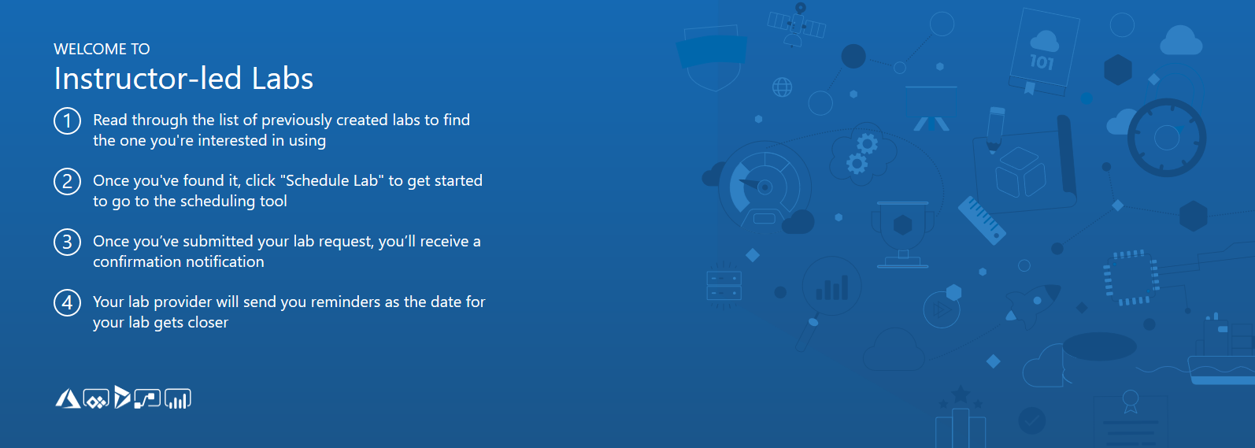
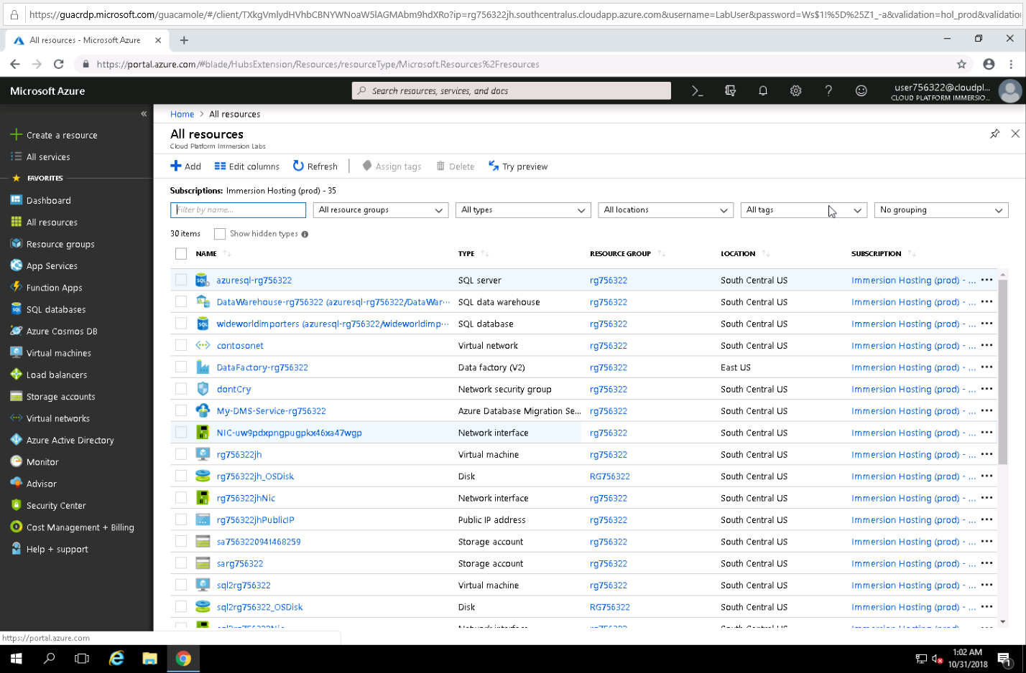
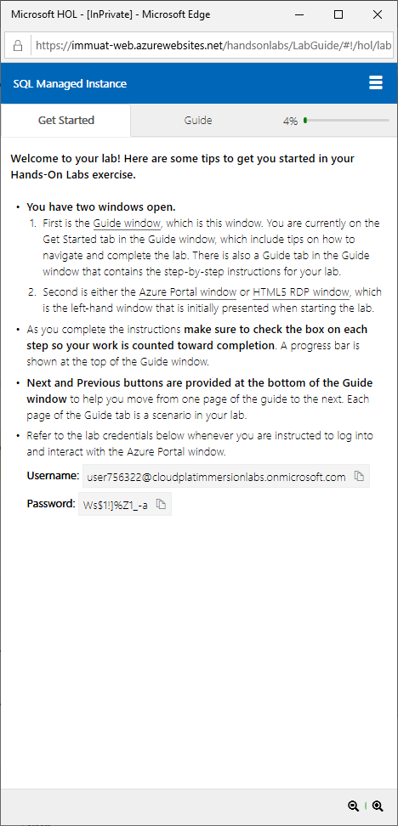
Azure SQL DB Managed Instance labs
Use InPrivate browser
Introduction to SQL Managed Instance
Migration using SQL Managed Instance
SQL Managed Instance data integration and business intelligence
Self-paced labs: https://www.microsoft.com/handsonlabs/selfpacedlabs
Instructor led labs: https://www.microsoft.com/handsonlabs/instructorledlabs
Notes:
Self-paced labs can be found here: https://www.microsoft.com/handsonlabs/selfpacedlabs
Search for Managed Instance
Instructor led labs/workshops can be found here: https://www.microsoft.com/handsonlabs/instructorledlabs
Pre-book these for the # of people, date and location.

Slide 45
Lab Creating a network and Managed Instance​ http://tinyurl.com/?????????
Notes:
The tinyurl for the instructor led labs/workshops will be emailed to the instructor after booking through the portal: https://www.microsoft.com/handsonlabs/instructorledlabs
Pre-book these for the # of people, date and location.

Slide 46
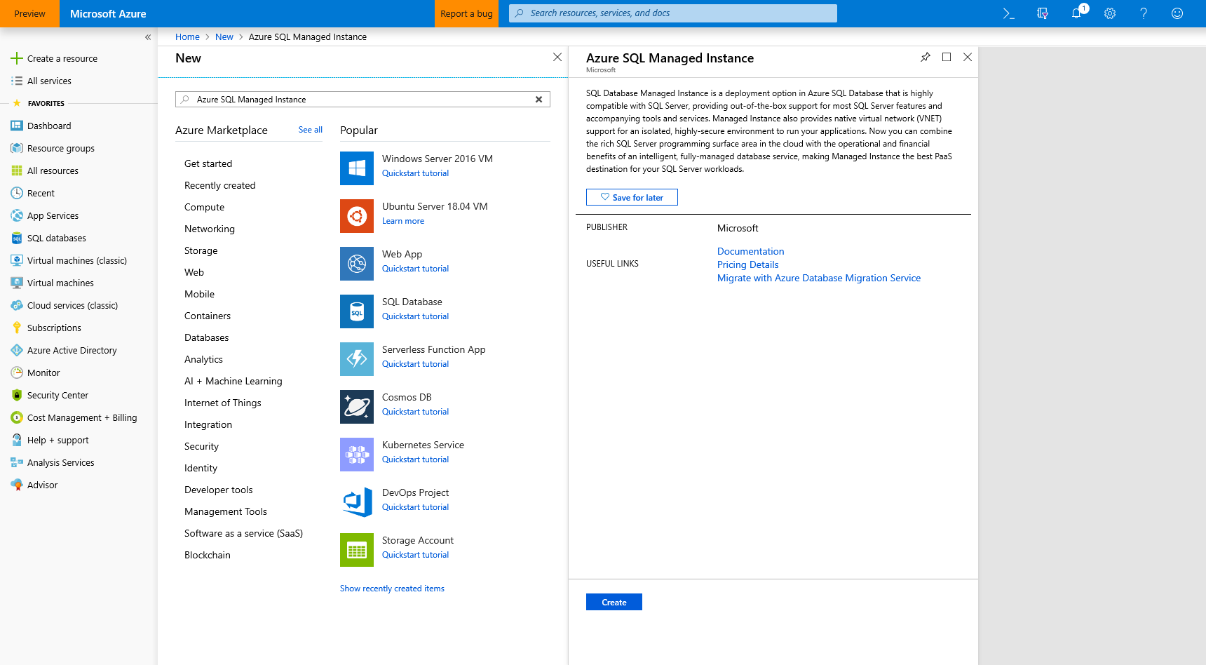
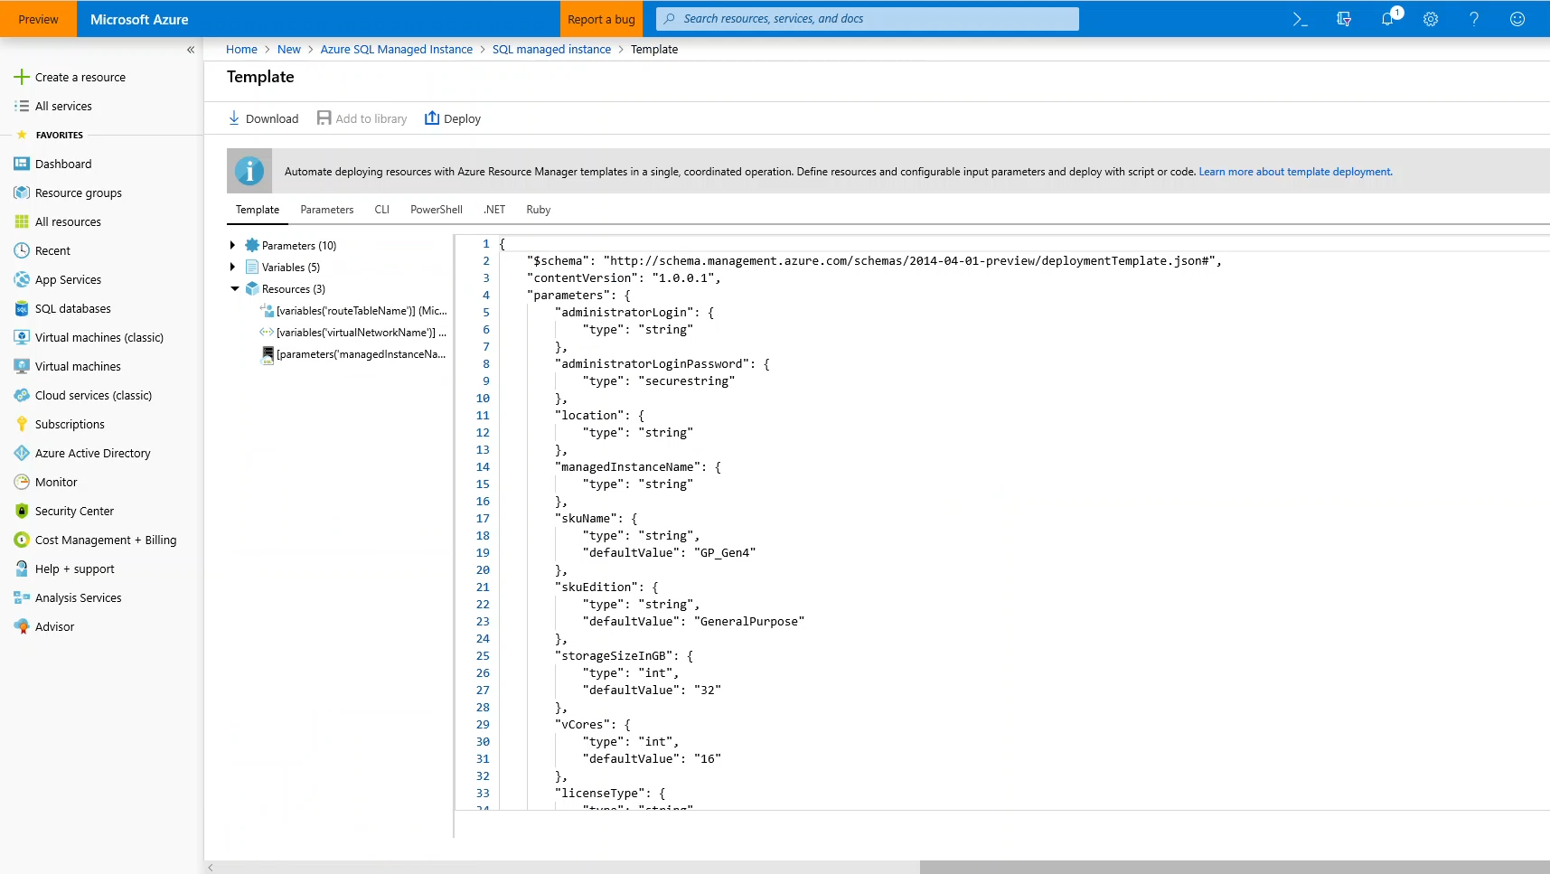
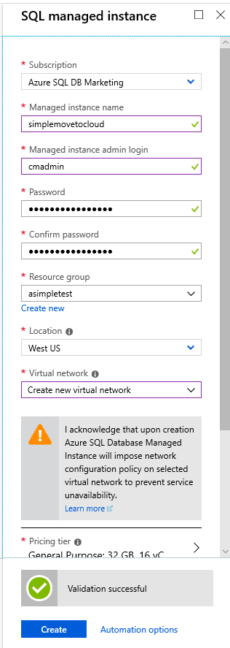
Azure SQL Database Managed Instance
Start provisioning in azure portal
Download template to automate
QuickStart walkthrough on docs
https://docs.microsoft.com/en-us/azure/sql-database/sql-database-managed-instance-get-started

Slide 47
Connecting to an Azure SQL Database Managed Instance
Driver/tool​ | Version​
.NET Framework​ | 4.6.1 (or .NET Core)​
ODBC driver​ | v17​
PHP driver​ | 5.2.0​
JDBC driver​ | 6.4.0​
Node.js driver​ | 2.1.1​
OLEDB driver​ | 18.0.2.0​
SSMS​ | 17.8.1 or higher​

Slide 48
Deployment resources
Portal Deployment walk-through
https://docs.microsoft.com/en-us/azure/sql-database/sql-database-managed-instance-create-tutorial-portal
https://docs.microsoft.com/en-us/azure/sql-database/sql-database-managed-instance-vnet-configuration
ARM Template Deployment walk-through
https://blogs.msdn.microsoft.com/sqlserverstorageengine/2018/07/02/deploy-azure-sql-managed-instance-network-environment-using-arm/
https://blogs.msdn.microsoft.com/sqlserverstorageengine/2018/05/15/creating-azure-sql-managed-instance-using-arm-templates/

Slide 49
Agenda
Intro to Azure SQL Database
Value prop, Platform benefits, TCO
Managed Instance overview
Managed Instance overview and architecture, Hands-on-lab
Security & Networking
Security overview, Networking considerations, demos
Features and capabilities
Key capabilities, limitations, backup & restore
Replication & Monitoring
Replication and Monitoring, demo
Migration
Migration overview and options, Hands-on-Lab
ETL/ELT Services overview
Running SSIS in the cloud, Hands-on-Lab
Hyperscale
Working with large workloads, demo
Closing
Q&A, technical resources, etc.,

Slide 50

Enterprise-grade security that is easy to use
PHYSICAL SECURITY
Trusted: most secure over last 7 years
NETWORK SECURITY
CLUSTER SECURITY
ACCESS MANAGEMENT
THREAT PROTECTION
INFORMATION PROTECTION
CUSTOMER DATA
Notes:
Key points
Defense-in-depth
Trusted: most secure over last 7 years

Slide 51
Securing the network
PHYSICAL SECURITY
NETWORK SECURITY
PLATFORM SECURITY
ACCESS MANAGEMENT
THREAT PROTECTION
INFORMATION PROTECTION
CUSTOMER DATA

Slide 52




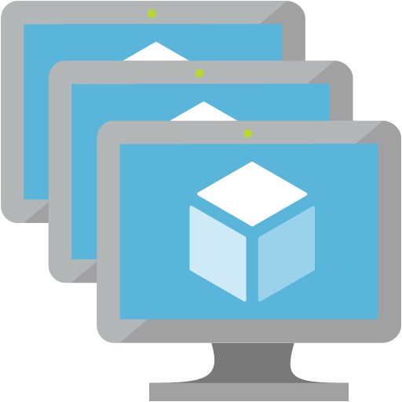

Legend:
certificate verification
Data
Management
Certificate
Certificate Authorities
Internet
Azure
VNet
TLS
TLS
Management & Deployment Plane
Azure
Azure SQL Database
Managed Instance
TLS
Service dependencies Azure
TLS
Customer applications & tools
On-Premises + Azure VNet
Maintenance
Corpnet

Slide 53






Hub & spoke architecture with MI
On-premises network
Hub virtual network
Spoke 1 virtual network
Workload subnet
Gateway Subnet
DMZ Subnet
NVA
vnet peering
ExpressRoute circuit
ExpressRoute Gateway
Management subnet
Management subnet
JumpBox
JumpBox
Active Directory subnet
Managed Instance subnet
Spoke 2 virtual network
Workload subnet
vnet peering
Management subnet
JumpBox

Slide 54

Host your application in the cloud or keep on-premises
SQL MI VNet
“VNet Integration”
Web app
App subnet
App Service
“VNet Integration”
Web app peered VNet
IaaS Hosted
App
App
Application VNet
MI subnet
Peering / VPN Channel
App subnet
IaaS Hosted
App
App Service
SQL Managed Instance #1
SQL Managed Instance #2
App
Express Route / VPN Gateway
On-premise app
App
Notes:
Key point(s)
You may choose to host application in the cloud either by using Azure App Service or some of Azure's virtual network (VNet) integrated options like Azure App Service Environment, Virtual Machine, Virtual Machine Scale Set. You could also take hybrid cloud approach and keep your applications on-premises.
https://docs.microsoft.com/en-us/azure/sql-database/sql-database-managed-instance-connect-app
Azure resources can communicate privately with each other through an Azure Virtual Network (VNet). A VNet is a logical isolation of the Azure cloud dedicated to your subscription.
You can implement multiple VNets within each Azure subscription and Azure region. Each VNet is isolated from other VNets.
You can connect Vnets to each other, enabling resources connected to either Vnet to communicate with each other across VNets
https://docs.microsoft.com/en-us/azure/virtual-network/virtual-networks-overview?toc=%2fazure%2fnetworking%2ftoc.json
Peering
Enables resources connected to different Azure Vnets within the same region to communicate with each other
https://docs.microsoft.com/en-us/azure/virtual-network/virtual-network-peering-overview?toc=%2fazure%2fnetworking%2ftoc.json
VPN Gateway
Enables resources connected to different Azure Vnets within different Azure region to communicate with each other
https://docs.microsoft.com/en-us/azure/vpn-gateway/vpn-gateway-howto-vnet-vnet-resource-manager-portal?toc=%2fazure%2fnetworking%2ftoc.json

Slide 55
Virtual network considerations
Be empty: The subnet must not contain any other cloud service associated to it, and it must not be Gateway subnet. You won’t be able to create Managed Instance in subnet that contains resources other than managed instance or add other resources inside the subnet later.
Have specific route table: The subnet must have a User Route Table (UDR) with 0.0.0.0/0 Next Hop Internet as the only route assigned to it.
Optional custom DNS: If custom DNS is specified on the VNet, Azure's recursive resolvers IP address (such as 168.63.129.16) must be added to the list.
No Service endpoint: The subnet must not have a Service endpoint (Storage or Sql) associated to it. Make sure that Service Endpoints option is Disabled when creating VNet.
Sufficient IP addresses: The subnet must have minimum of 16 IP addresses. For more information. By design, a Managed Instance needs a minimum of 16 IP addresses in a subnet and may use up to 256 IP addresses. As a result, you can use subnet masks /28 to /24 when defining your subnet IP ranges.
Azure uses five IP addresses in the subnet for its own needs
Each General Purpose instance needs two addresses
Each Business Critical instance needs four addresses
Reference docs for latest info: https://docs.microsoft.com/en-us/azure/sql-database/sql-database-managed-instance-vnet-configuration#requirements
Notes:
Be empty: The subnet must not contain any other cloud service associated to it, and it must not be Gateway subnet. You won’t be able to create Managed Instance in subnet that contains resources other than managed instance or add other resources inside the subnet later.
Have specific route table: The subnet must have a User Route Table (UDR) with 0.0.0.0/0 Next Hop Internet as the only route assigned to it.
Optional custom DNS: If custom DNS is specified on the VNet, Azure's recursive resolvers IP address (such as 168.63.129.16) must be added to the list.
No Service endpoint: The subnet must not have a Service endpoint (Storage or Sql) associated to it. Make sure that Service Endpoints option is Disabled when creating VNet.
Sufficient IP addresses: The subnet must have minimum of 16 IP addresses. For more information. By design, a Managed Instance needs a minimum of 16 IP addresses in a subnet and may use up to 256 IP addresses. As a result, you can use subnet masks /28 to /24 when defining your subnet IP ranges.
Azure uses five IP addresses in the subnet for its own needs
Each General Purpose instance needs two addresses
Each Business Critical instance needs four addresses

Slide 56
Virtual network guidance
A Managed Instance must be deployed in an Azure Virtual Network
Allows for connecting directly from an on-premises network
Allows for connecting linked servers or other on-premises data stores
Allows for connecting to additional Azure resources
Plan your deployment
Managed Instance requires a minimum of 16 IP addresses in a subnet and may use up to 256 IP addresses
If deploying multiple Managed Instances inside the subnet, you need to optimize the subnet size
The default values create a subnet that takes all the VNet address space, allowing for only Managed Instance inside the virtual network
Routes
Effective routes on the Managed Instance subnet are not supported
Routes can be user-defined (UDR) or Border Gateway Protocol (BGP) routes propagated to network interfaces through ExpressRoute or site-to-site VPN connections
For BGP routes, create a 0.0.0.0/0 Next Hop Internet route and apply it to the Managed Instance subnet
Network Security Groups (NSG)
NSGs on the Managed Instance subnet are not supported
Notes:
A Managed Instance must be deployed in an Azure Virtual Network
Allows for connecting directly from an on-premises network
Allows for connecting linked servers or other on-premises data stores
Allows for connecting to additional Azure resources
Plan your deployment
Managed Instance requires a minimum of 16 IP addresses in a subnet and may use up to 256 IP addresses
If deploying multiple Managed Instances inside the subnet, you need to optimize the subnet size
The default values create a subnet that takes all the VNet address space, allowing for only Managed Instance inside the virtual network
Routes
Effective routes on the Managed Instance subnet are not supported
Routes can be user-defined (UDR) or Border Gateway Protocol (BGP) routes propagated to network interfaces through ExpressRoute or site-to-site VPN connections
For BGP routes, create a 0.0.0.0/0 Next Hop Internet route and apply it to the Managed Instance subnet
Network Security Groups (NSG)
NSGs on the Managed Instance subnet are not supported

Slide 57
Virtual network guidance
Considerations when creating a new Virtual Network for Managed Instance
Calculate the subnet size
Assess the needs for the rest of the Vnet
Disable Service end points
Create new ARM Virtual Network
Name | Any valid name
Address space | Any valid address range, such as 10.14.0.0/24
Subscription | Your subscription
Resource Group | Any valid resource group (new or existing)
Location | Any valid location
Subnet name | Any valid subnet name, such as mi_subnet
Subnet address range | Any valid subnet address, such as 10.14.0.0/28. Use a subnet address space smaller than the address space itself to allow space to create other subnets in the same VNet, such as a subnet for hosting test / client apps or gateway subnets to connect from on-prem or other VNets.
Service endpoints | Disabled

Slide 58
Virtual network guidance
Create the required route table and associate it
Create new Route table
0.0.0.0/0 Next Hop Internet**
Associate route table with the Managed Instance subnet
Name | Any valid name
Subscription | Your subscription
Resource Group | Select the resource group you created in the previous procedure
Location | Select the location you specified in the previous procedure
Disable BCP route propagation | Enabled

Slide 59
Demo
Preparing a subnet for deployment of Managed Instance
Notes:
Run scripts C:\Demo Materials\Scripts\Deployment\Validate Network.ps1
Run the following PowerShell script to determine if the Vnet & subnet can take a managed instance.
(explain and run script)
$scriptUrlBase = 'https://raw.githubusercontent.com/Microsoft/sql-server-samples/master/samples/manage/azure-sql-db-managed-instance/prepare-subnet'
$parameters = @{
subscriptionId = '<subsriptionid>'
resourceGroupName = '<rgname>'
virtualNetworkName = '<vnetname>'
subnetName = '<subnetname>'
}
Invoke-Command -ScriptBlock ([Scriptblock]::Create((iwr ($scriptUrlBase+'/prepareSubnet.ps1?t='+ [DateTime]::Now.Ticks)).Content)) -ArgumentList $parameters

Slide 60








N-tier Architecture in Customer Data Center
Data center network
Web tier
Business tier
Data tier
Internet
Load balancer
Load balancer
Load balancer
SQL HA Cluster
Management
Active Directory
JumpBox

Slide 61





N-tier Architecture in Azure
Data center network
Web tier subnet
Business tier subnet
Managed Instance subnet
Internet
Azure application
gateway
Load balancer
Management subnet
Azure Active Directory
JumpBox

Slide 62
Securing the platform
PHYSICAL SECURITY
Enhanced monitoring
Collecting of low-fidelity anomalous activity
Monitoring PERF for traits
Red Team / Blue Team
NETWORK SECURITY
PLATFORM SECURITY
ACCESS MANAGEMENT
THREAT PROTECTION
INFORMATION PROTECTION
CUSTOMER DATA

Slide 63
Virtual cluster
VNet
Virtual cluster
SQL
Node
GW
primary node
mymi.<clusterid>.database.windows.net
TLS
ILB
Node
GW
Windows Firewall
TDS endpoint
(Private IP)
Node
SQL
Engine
TLS
SQL Management
Node Agent
TLS
LB
GW
SQL Management (Public IP)
SQL Management (public IP)
TDS endpoint (private IP)
Notes:
We assume breach…
Enhanced monitoring of our Azure Assets
Collection of low-fidelity anomalous activity (automated hunting)
Monitoring PERF for traits of crypto currency mining
… and large set of other detections that we don’t talk about publicly
Attack team, SQL Red Team, tries to get in, gain a foothold, escalate privileges, and maintain persistence
SQL Blue Team practices defense-in-depth
When we detect something, e.g., failed login attempts, we defend…
If it involves customer, we will notify
Many times this is the customer’s own security and compliance scanners!

Slide 64
Platform/Service Security
We assume breach…
Enhanced monitoring of our Azure Assets
Collection of low-fidelity anomalous activity (automated hunting)
Monitoring PERF for traits of crypto currency mining
… and large set of other detections that we don’t talk about publicly
Attack team, SQL Red Team, tries to get in, gain a foothold, escalate privileges, and maintain persistence
SQL Blue Team practices defense-in-depth
When we detect something, e.g., failed login attempts, we defend…
If it involves customer, we will notify
Many times this is the customer’s own security and compliance scanners!

Slide 65
Configuring authentication
PHYSICAL SECURITY
Azure Active Directory
Provides an alternative to SQL authentication.
Helps to stop the proliferation of user identities across Azure SQL logical servers and SQL DBs
Use benefits provided by Azure AD
NETWORK SECURITY
PLATFORM SECURITY
ACCESS MANAGEMENT
THREAT PROTECTION
INFORMATION PROTECTION
CUSTOMER DATA
Notes:
Provides an alternative to SQL authentication.
Helps to stop the proliferation of user identities across Azure SQL logical servers and SQL DBs
Use benefits provided by Azure AD (e.g., supports new user accounts, or enables password rotation)
Central permission management for:
Individual users
Groups
External/guest users with and w/o Azure AD access
Integrated Windows auth and single sign-on
Universal/Interactive auth w/o hard-coded passwords
Use of Managed Service Instance for VMs and Windows certificates
Supports: Interactive Multi-factor authentication (MFA) Users w/o hard coded password (interactive) Federated accounts Guest accounts (B2B)
Azure AD Conditional Access for configuring domain accounts for MFA
Can impose MFA without asking domain administrator to make global change
SSMS (since 17.1+)
B2B requires SSMS 17.4+
SQL Package
Import/Export
SSDT (in preview)
SQLCMD, BCP (soon)
Drivers:
.NET 4.7.2 (in preview)
ODBC 17.1, JDBC, … (soon)

Slide 66
Azure Active Directory Authentication
Central ID Management
Simplified Permission Management
Can help you Eliminate Storing Passwords
With support for Multi-factor authentication
Universal / Interactive Authentication
Flexible Configuration
Supported in many Tools and Drivers
Notes:
Provides an alternative to SQL authentication.
Helps to stop the proliferation of user identities across Azure SQL logical servers and SQL DBs
Use benefits provided by Azure AD (e.g., supports new user accounts, or enables password rotation)
Central permission management for:
Individual users
Groups
External/guest users with and w/o Azure AD access
Integrated Windows auth and single sign-on
Universal/Interactive auth w/o hard-coded passwords
Use of Managed Service Instance for VMs and Windows certificates
Supports: Interactive Multi-factor authentication (MFA) Users w/o hard coded password (interactive) Federated accounts Guest accounts (B2B)
Azure AD Conditional Access for configuring domain accounts for MFA
Can impose MFA without asking domain administrator to make global change
SSMS (since 17.1+)
B2B requires SSMS 17.4+
SQL Package
Import/Export
SSDT (in preview)
SQLCMD, BCP (soon)
Drivers:
.NET 4.7.2 (in preview)
ODBC 17.1, JDBC, … (soon)

Slide 67
Other Capabilities
Row-level security
Data Discovery & Classification
(very early prototype in preview for Azure SQL Database Singletons/Pools)
Data Masking (dynamic, static in private preview)

Slide 68
Demo
Azure Active Directory Integrated Authentication
Notes:
Reference:
https://docs.microsoft.com/en-us/azure/sql-database/sql-database-aad-authentication-configure#provision-an-azure-active-directory-administrator-for-your-managed-instance

Slide 69
Monitoring and auditing
SQL Auditing
Integration with Log Analytics and Event Hubs for SQL DB
Singletons/pools (coming to M.I. soon)
Advanced Threat Protection
Vulnerability Assessment
Threat Monitoring (3 classes of threats)
PHYSICAL SECURITY
NETWORK SECURITY
PLATFORM SECURITY
ACCESS MANAGEMENT
THREAT PROTECTION
INFORMATION PROTECTION
CUSTOMER DATA
Notes:
SQL Auditing
Integration with Log Analytics and Event Hubs for SQL DB singletons/pools (coming to M.I. soon)
Advanced Threat Protection
Vulnerability Assessment
Threat Monitoring (3 classes of threats)

Slide 70
Threat Protection
SQL Auditing
Integration with Log Analytics and Event Hubs for SQL DB singletons/pools (coming to M.I. soon)
Advanced Threat Protection
Vulnerability Assessment
Threat Monitoring (3 classes of threats)

Slide 71
Demo
Threat Detection
Notes:
Demo code & instructions on github: https://github.com/Microsoft/azure-sql-security-sample

Slide 72
Protecting the data
PHYSICAL SECURITY
Encryption-in-flight
(aka. Transport Layer Security TLS)
Encryption-at-rest
(aka. Transparent Data Encryption TDE) Service- or User-managed keys Backup encryption
Encryption-in-use (Always Encrypted)*
Key management with Azure Key Vault
NETWORK SECURITY
PLATFORM SECURITY
ACCESS MANAGEMENT
THREAT PROTECTION
INFORMATION PROTECTION
CUSTOMER DATA

Slide 73
Agenda
Intro to Azure SQL Database
Value prop, Platform benefits, TCO
Managed Instance overview
Managed Instance overview and architecture, Hands-on-lab
Security & Networking
Security overview, Networking considerations, demos
Features and capabilities
Key capabilities, limitations, backup & restore
Replication & Monitoring
Replication and Monitoring, demo
Migration
Migration overview and options, Hands-on-Lab
ETL/ELT Services overview
Running SSIS in the cloud, Hands-on-Lab
Hyperscale
Working with large workloads, demo
Closing
Q&A, technical resources, etc.,

Slide 74



Authentication
On-premises / Private cloud
Azure SQL Database
Azure Active Directory
Active Directory
ADALSQL
Application
SSMS
SSDT
Connection string-based authentication
SQL package
ADO.NET 4.6
Notes:
ADALSQL = Active Directory Authentication Library for SQL server
Reference links:
https://docs.microsoft.com/en-us/azure/sql-database/sql-database-aad-authentication
https://docs.microsoft.com/en-us/azure/sql-database/sql-database-aad-authentication-configure
https://docs.microsoft.com/en-us/dotnet/framework/data/adonet/ado-net-overview

Slide 75
General Purpose
Feature | Description
Number of vCores* | 8, 16, 24 (Gen 4) 8, 16, 24, 32, 40, 64, 80 (Gen 5)
SQL Server version / build | SQL Server (latest available)
Min storage size | 32 GB
Max storage size | 8 TB
Max storage per database | Determined by the max storage size per instance
Expected storage IOPS | 500-7500 IOPS per data file (depends on data file). See Premium Storage
Number of data files (ROWS) per the database | Multiple
Number of log files (LOG) per database | 1
Managed automated backups | Yes
HA | Based on remote storage and Azure Service Fabric
Built-in instance and database monitoring and metrics | Yes
Automatic software patching | Yes
VNet - Azure Resource Manager deployment | Yes
VNet - Classic deployment model | No
Portal support | Yes
Redundant nodes
Azure storage accounts
Active compute nodes

Slide 76
Business Critical
Primary endpoint
(read-write)
Read-only endpoint
Feature | Description
Number of vCores* | 8, 16, 24, 32 (Gen 4) 8, 16, 24, 32, 40, 64, 80 (Gen 5)
SQL Server version / build | SQL Server (latest available)
Additional features | In-Memory OLTP 1 additional read-only replica (Read Scale-Out)
Min storage size | 32 GB
Max storage size | Gen 4: 1 TB (all vCore sizes Gen 5:1 TB for 8, 16 vCores 2 TB for 24 vCores 4 TB for 32, 40, 64, 80 vCores
Max storage per database | Determined by the max storage size per instance
Number of data files (ROWS) per the database | Multiple
Number of log files (LOG) per database | 1
Managed automated backups | Yes
HA | Based on Always On Availability Groups and Azure Service Fabric
Built-in instance and database monitoring and metrics | Yes
Automatic software patching | Yes
VNet - Azure Resource Manager deployment | Yes
VNet - Classic deployment model | No
Portal support | Yes
Always On AG
SQL
Super-fast SSD
SQL
Primary replica
Secondary replica
SQL
SQL
Secondary replica
Secondary replica
Business Critical service tier: collocated compute and storage

Slide 77
Built-in high availability
Single logical database
DB
Logical
Availability group
Ack
value
Read
write
Seamless and Transparent
P
Ack
Write
S
Write
Ack
S
Physical
Reads are completed at the primary
Writes are replicated to secondaries
Notes:
High Availability is handled behind the scenes automatically
For General Purpose there is a four-node Availability Group
The secondary is non-readable
For Business Critical there is a three-node Availability Group
One secondary is readable, and the other is non-readable (Application Intent = ReadOnly)
An on-prem SQL Server Availability Group cannot be extended to a Managed Instance

Slide 78
Surface area of Managed Instance
MI is always on latest and greatest SQL engine version
Certify your code for database compatibility level not for a version
Take advantage of new features (Temporal, JSON, Graph Database, etc.)
Use rich T-SQL surface area, check out documentation page
Your code can be SQL deployment model aware if necessary
SERVERPROPERTY (‘EngineEdition’) = 8 uniquely identifies MI
Current limitations (will be removed later this year)
Time is UTC . Use AT TIME ZONE to add local time zone experience
Instance collation is fixed (affects tempdb and system databases)
Always on the latest and greatest SQL engine version
Your code can be SQL deployment model aware if necessary
Note: current limitation being removed later this year
Notes:
MI is always on latest and greatest SQL engine version
Certify your code for database compatibility level not for a version
Take advantage of new features (Temporal, JSON, Graph Database, etc.)
Use rich T-SQL surface area, check out documentation page
Your code can be SQL deployment model aware if necessary
SERVERPROPERTY (‘EngineEdition’) = 8 uniquely identifies MI
Current limitations (will be removed later this year)
Time is UTC . Use AT TIME ZONE to add local time zone experience
Instance collation is fixed (affects tempdb and system databases)

Slide 79
Database Compatibility Based Certification
Microsoft Database Compatibility Level Protection
Full Functional protection once assessment tool runs clean.
Maintaining backward compatibility is very important to SQL Server team.
Query Plan shape protection.
Overall process
Use Database Migration Assistant (DMA) and Database Experimentation Assistant (DEA) for assessment.
Migrate database and keep/set source Database Compatibility Level on target.
Perform minimal testing or as determined by your organization.
Contact Microsoft
Explore jointly on how to use Database Compatibility based certification.
Microsoft database compatibility level protection
Easy to use tools to help you access migration
Notes:
Microsoft Database Compatibility Level Protection
Full Functional protection once assessment tool runs clean.
Maintaining backward compatibility is very important to SQL Server team.
Query Plan shape protection.
Overall process
Use Database Migration Assistant (DMA) and Database Experimentation Assistant (DEA) for assessment.
Migrate database and keep/set source Database Compatibility Level on target.
Perform minimal testing or as determined by your organization.
Contact Microsoft – Explore jointly on how to use Database Compatibility based certification.

Slide 80
App compatibility: what’s is missing?
Features with a better alternative in Azure
Always-On Availability Groups: local HA, active geo-replication
Windows Authentication: Azure Active Directory is the alternative.
Management Data Warehouse : OMS integration is the alternative.
Retired features
Database Mirroring: built-in HA / geo-replication
Extended stored procedures: customers should use CLR
Features considered post-GA
Filestream, Filetable
Cross-instance distributed transactions (MS DTC)
Stretch Database
PolyBase
Notes:
Features with a better alternative in Azure
Always-On Availability Groups: local HA, active geo-replication
Windows Authentication: Azure Active Directory is the alternative.
Management Data Warehouse : OMS integration is the alternative.
Retired features
Database Mirroring: built-in HA / geo-replication
Extended stored procedures: customers should use CLR
Features considered post-GA
Filestream, Filetable
Cross-instance distributed transactions (MS DTC)
Stretch Database
PolyBase

Slide 81
Azure AD
Provides an alternative to SQL Server authentication so database permissions can be managed via external (Azure AD) groups
Supports:
Token-based authentication for applications connecting to SQL Database
ADFS or native user/password authentication for a local Azure Active Directory without domain synchronization
Multi-Factor Authentication (MFA)
Windows logins are not supported
CREATE LOGIN... FROM WINDOWS is not permitted
SQL logins are fully supported when created using:
FROM CERTIFICATE
FROM ASYMMETRIC KEY,
FROM SID
Azure AD user who creates the Managed Instance has unrestricted administrative privileges by default
This can be changed from an individual to a security group account
Azure AD non-admin database users can be created using CREATE USER… FROM EXTERNAL PROVIDER syntax

Slide 82
CLR Considerations
Managed Instance cannot access file shares and Windows folders
Only CREATE ASSEMBLY FROM BINARY is supported
CREATE ASSEMBLY FROM FILE is not supported
ALTER ASSEMBLY can’t reference files

Slide 83
SQL Server Agent
Built into Managed Instance
Azure SQL Database requires using on-premises SQL Server Agent, Azure Automation, Elastic Jobs, or PowerShell
Always running
Services cannot be stopped or restarted like they can with on-premises
Option to auto-restart SQL Server if it stops unexpectedly is disabled
Option to auto-restart SQL Server Agent if it stops unexpectedly is disabled
Forwarding SQL Server events is disabled
On-premises SQL Server Agent allows for forwarding events to another server but this is currently not an option for a Managed Instance
Connection
Alias local host server is predefined for a Managed Instance, whereas on-premises SQL Server Agent allows that to be configured if needed
Creating jobs
Creating jobs is as simple and easy as on-premises
Jobs can be created using the UI or T-SQL
Alert System
Functions the same as on-premises for sending email alerts
SQLCMD
Cannot be called within a SQL Server Agent job
Can be used to connect to a Managed Instance

Slide 84
Service broker within instances
Service broker is on by default for all user databases
Cross-instance service broker is not supported
CREATE ROUTE does not work with ADDRESS other than LOCAL
ALTER ROUTE does not work with ADDRESS other than LOCAL

Slide 85
Database mail
Fully supported in Managed Instance
Functions the same as on-premises to set up and use
Azure SQL Database does not have Database Mail support

Slide 86
Replication support
Supported
Snapshot replication. Same functionality as on-premises
Transactional replication
Unsupported
Peer-to-peer replication
Merge replication
Heterogeneous replication
Oracle publisher
For comparison, Azure SQL Database only supports being a transactional replication push subscriber
Some restrictions when used with a Managed Instance
Updatable subscriptions are not permitted
Publisher and distributor must be in the same location
If publisher and distributor are in a Managed Instance, Azure file share must be used to store data and schema from the publication
Connections to the Distributor must use SQL authentication
Additions to support Managed Instance
New fields have been added in replication-related tables in msdb
job_login, job_password, storage_connection_string
SSMS replication wizard supports using a Managed Instance

Slide 87
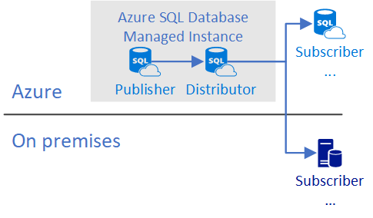
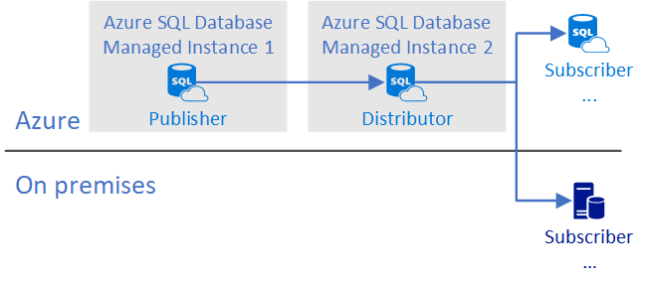
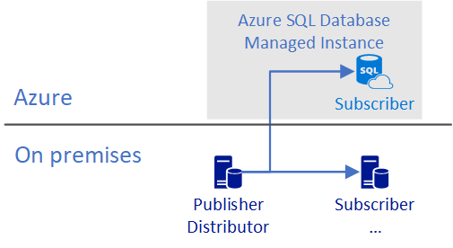
Publisher with Local Distributor on MI
Publisher with Remote Distributor on MI
Publisher and distributor on-premises with subscriber on managed instance

Slide 88
Database Compatibility Based Certification
Microsoft Database Compatibility Level Protection
Full Functional protection once assessment tool runs clean.
Maintaining backward compatibility is very important to SQL Server team.
Query Plan shape protection.
Overall process
Use Database Migration Assistant (DMA) and Database Experimentation Assistant (DEA) for assessment.
Migrate database and keep/set source Database Compatibility Level on target.
Perform minimal testing or as determined by your organization.
Microsoft database compatibility level protection
Easy to use tools to help you access migration
Notes:
Microsoft Database Compatibility Level Protection
Full Functional protection once assessment tool runs clean.
Maintaining backward compatibility is very important to SQL Server team.
Query Plan shape protection.
Overall process
Use Database Migration Assistant (DMA) and Database Experimentation Assistant (DEA) for assessment.
Migrate database and keep/set source Database Compatibility Level on target.
Perform minimal testing or as determined by your organization.
Contact Microsoft – Explore jointly on how to use Database Compatibility based certification.

Slide 89
App compatibility: what’s is missing?
Features with a better alternative in Azure
Always-On Availability Groups: local HA, active geo-replication
Windows Authentication: Azure Active Directory is the alternative.
Management Data Warehouse : OMS integration is the alternative.
Retired features
Database Mirroring: built-in HA / geo-replication
Extended stored procedures: customers should use CLR
Features considered post-GA
Filestream, Filetable
Cross-instance distributed transactions (MS DTC)
Stretch Database
PolyBase
Notes:
Features with a better alternative in Azure
Always-On Availability Groups: local HA, active geo-replication
Windows Authentication: Azure Active Directory is the alternative.
Management Data Warehouse : OMS integration is the alternative.
Retired features
Database Mirroring: built-in HA / geo-replication
Extended stored procedures: customers should use CLR
Features considered post-GA
Filestream, Filetable
Cross-instance distributed transactions (MS DTC)
Stretch Database
PolyBase

Slide 90
User Database File Layout Considerations
Data file default initial size is 16MB with 16MB auto growth
These can and should be adjusted for your workload
File size limit is 8TB in General Purpose
Log file default initial size is 8MB with 16MB auto growth
This can and should be adjusted for your workload
Additional data files/filegroups can be added
Only using an ALTER DATABASE statement and the FILENAME clause is not permitted
Paths and File Names are chosen for you
Different from Azure SQL Database where additional files are not allowed
Multiple log files are not supported (and should not be needed)
A backup with multiple files/filegroups can be restored
Each user database has a FILESTREAM filegroup for In-Memory OLTP checkpoint files
Multiple log files are not supported (and should not be needed)

Slide 91
Tempdb Data File Considerations
Tempdb Tuning Options
Multiple tempdb data files are created automatically
Default data file and log file sizes are 16MB
These can and should be adjusted for your workload
Default auto-growth for data files is set to 256MB
This can be adjusted for your workload if needed
Default auto-growth for the log file is set to 64MB
This can be adjusted for your workload if needed
Additional tempdb data files can be created if needed
Files can only be created using an ALTER DATABASE statement and the FILENAME clause is not permitted
Well-known tempdb tuning ‘fixes’ are on by default
Data files auto-grow at the same time
Single-page allocations disabled
This default behavior was introduced in SQL Server 2016 for on-premises
Tempdb Resizing
Sometimes necessary to resize tempdb after excessive growth
E.g. from a runaway query with a large memory spill to tempdb
The SQL Server Service cannot be restarted manually to make tempdb resize back to the configured size
This is the usual way of dealing with the situation in on-premises
It is possible to shrink the database or shrink one or more files if needed
Be aware that just as with on-premises, tempdb shrinking may not be able to progress if it encounters certain data page types
This is usually solved on-premises by restarting the instance
A better option may be to restrict tempdb from growing out of control by specifying a maximum file size

Slide 92
Backup/restore

Slide 93
Backups are automatic
Database backup schedule is the same as Azure SQL Database
Full database backups occur weekly
Differential backups generally happen every few hours
Transaction log backups generally happen every 5‒10 minutes
Frequency is based upon performance level and amount of database activity
COPY_ONLY, URL-based backups can be used to perform manual full database backups
Not available on Azure SQL Database
Backup retention is 7 days by default
Configurable up to 35 days for General Purpose and Business Critical

Slide 94
Restore considerations
Point-in-time restores are possible and must be performed manually using the Azure Portal
Restoring automated backups from within SSMS is not allowed
You can only restore using the Azure Portal
COPY_ONLY, URL-based full backups can be restored using SSMS to a Managed Instance only
Cannot be restored to on-premises as Managed Instance uses a higher build than on-premises instances
Databases with multiple log files cannot be restored
Secondary log files must be removed prior to backing up and restoring to a Managed Instance
Can restore backups in a specific DB Compatibility
Supports up to SQL 2005

Slide 95
Agenda
Intro to Azure SQL Database
Value prop, Platform benefits, TCO
Managed Instance overview
Managed Instance overview and architecture, Hands-on-lab
Security & Networking
Security overview, Networking considerations, demos
Features and capabilities
Key capabilities, limitations, backup & restore
Replication & Monitoring
Replication and Monitoring, demo
Migration
Migration overview and options, Hands-on-Lab
ETL/ELT Services overview
Running SSIS in the cloud, Hands-on-Lab
Hyperscale
Working with large workloads, demo
Closing
Q&A, technical resources, etc.,

Slide 96




Using failover groups with Managed Instance
User device
Azure Traffic Manager
End user traffic
Capabilities
Active / Standby
All databases in the instance are automatically replicated
Automatic or manual failover
Read-write listener for read-write database connections
Read-only listener for read-intended database connections
Scenarios
Transparent recovery from outage
Load-balancing read-only workloads
Failback after outage is mitigated
Ingress LB
Ingress LB
DNS zone
Geo-replication
Application
Application VM
Application VM
Application VM
DB traffic
Failover group listener
VNET
VNET
Primary region
Secondary region

Slide 97
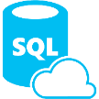

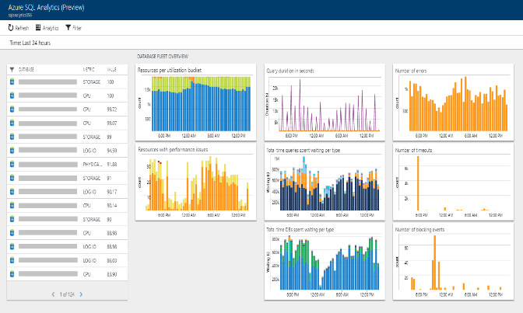


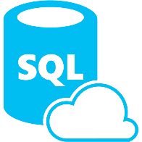








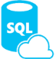






Monitoring with Azure SQL Analytics
Preview
Azure SQL Analytics
Intelligent performance monitoring
Telemetry stored for 30* days
Elastic pools
Log Analytics queries
Azure SQL Database
Custom
Alerting
Performance monitoring dashboard
Diagnostics telemetry
Managed Instances
Power BI
Stream Analytics
Partner monitoring tools
Databases in managed instance
Azure SQL
database
Event
Hub
Azure
Storage
Functions
App services
Custom integrations
Notes:
Key points
Intelligent Insights - Built in analytics diagnostics to detect performance issues with your databases.
Stores telemetry for 30 days. Can be extended.
Configure alerts to inform you when a database is reaching a limit like 95% of CPU or Storage.
Can run in parallel to pipe telemetry to Event hub and Azure storage for use with 3rd party tools.
Reference
https://docs.microsoft.com/en-us/azure/azure-monitor/insights/azure-sql

Slide 98
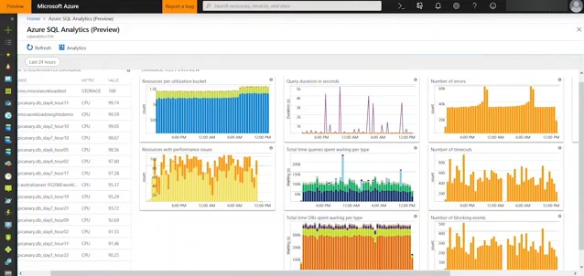
Demo Azure SQL Analytics
Notes:
Demo
Demo Azure SQL Analytics in your subscription against databases and drill into the AdventureWorks database to show high queries.
Prerequisites
Follow the steps in the documentation to configure Azure SQL Analytics in your Azure subscription:
https://docs.microsoft.com/en-us/azure/azure-monitor/insights/azure-sql
AdventurWorks database on GitHub
https://docs.microsoft.com/en-us/sql/samples/adventureworks-install-configure?view=sql-server-2017
Use the following query with the lock statement, which locks the table and slow everything down.
SELECT * FROM dbo.adventureworks with (XLOCK)

Slide 99
Agenda
Intro to Azure SQL Database
Value prop, Platform benefits, TCO
Managed Instance overview
Managed Instance overview and architecture, Hands-on-lab
Security & Networking
Security overview, Networking considerations, demos
Features and capabilities
Key capabilities, limitations, backup & restore
Replication & Monitoring
Replication and Monitoring, demo
Migration
Migration overview and options, Hands-on-Lab
ETL/ELT Services overview
Running SSIS in the cloud, Hands-on-Lab
Hyperscale
Working with large workloads, demo
Closing
Q&A, technical resources, etc.,

Slide 100
Tools for your migration journey
Data Migration Assistant (DMA)
Enables upgrades to SQL Server and Azure SQL Database
Azure Hybrid Benefit for SQL Server
Maximizes current on-premises license investments to facilitate migration
Azure SQL Database Managed Instance
Facilitates lift and shift migration from on-premises SQL Server to PaaS
Azure SQL Database Managed Instance
Azure Database Migration Service (DMS)
Data Migration Assistant (DMA)
Azure Hybrid Benefit for SQL Server

Slide 101
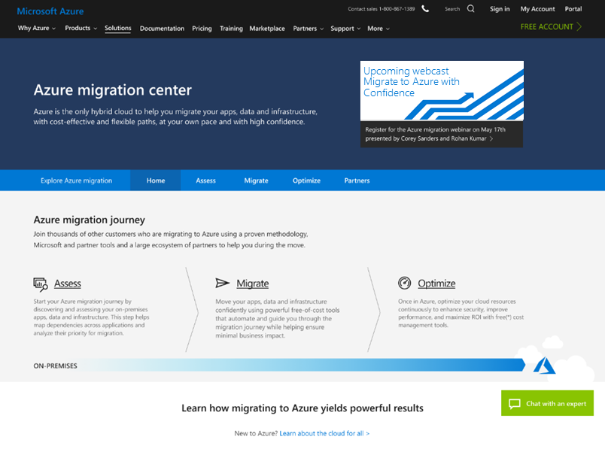
Your single destination for all thing's migration
Azure migration center
Provides guidance, tools, and partners in context of your migration scenario
https://azure.microsoft.com/en-us/migration/
Notes:
Enables you to:
Build your case, find others like you
Assess your environment
Identify the right migration strategies
Optimize your cloud resources
Connects you to a migration expert
Chat enabled, backed by engineering resources
Guides you to FastTrack, partner, seller, or DIY outcomes

Slide 102
Expedite migration with Azure Database Migration Service
Fully managed Azure service platform for seamless and frictionless data migration at scale
Database migrations with minimal downtime
Migrate SQL Server & 3rd party databases to Azure SQL Database
Built for scale and reliability
Azure Database Migration Service
SQL DB
Notes:
Fully managed Azure service platform for seamless and frictionless data migration at scale
Database migrations with minimal downtime
Migrate SQL Server & 3rd party databases to Azure SQL Database
Built for scale and reliability
Navigate to website and show experience
https://datamigration.microsoft.com/

Slide 103

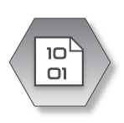



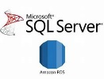










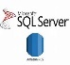
Azure Database Migration Service
Microsoft Subscription
Customer Subscription
On-Premise
Azure Resource Manager (ARM)
On-premises network
Azure Storage Account
Private ER
connection
My
Azure Portal
State management data
Migration results
Subnet used for DMS
ER Gateway
NIC
S2S VPN Tunnel
Virtual Machine
VPN
Gateway
PowerShell
DMS Resource Provider
VNET 1
Migration scenario server
VM locked down
Exclusive for DMS process
Auto upgrades
S2S SSTP
Tunnel
P2S SSTP/IKE
Tunnel
VNET peering
My
CLI commands
Authentication
Authorization
Throttling
VPN
Gateway
Service Bus Queue
VNET 2

Slide 104
Azure Database migration journey
Assess
Migrate
Optimize
Notes:
Assess
When the data sources have been identified, the next step is to assess on-premises SQL Server instance(s) migrating to Azure SQL database(s) to understand the gaps between the source and target instances. Use the Data Migration Assistant (DMA) to assess your source database before migrating to Azure SQL Database.
Migrate
After you have the necessary prerequisites in place and have completed the tasks associated with the Pre-migration phase, you are ready to perform the schema and data migration.
Optimize
After you have successfully completed the Migration phase, you need to go through a series of post-migration tasks to ensure that everything is functioning as smoothly and efficiently as possible.
The post migration phase is crucial for reconciling any issues with data accuracy and completeness, as well as addressing potential performance issues with the workload.

Slide 105
Azure Database migration journey
SQL
Managed Instance
*
Migrate
Rehost
(lift and shift)
Enables optimization during or post migration (fully managed service)
Enables rehosting or light refactoring for most apps
Refactor
Rearchitect
Assess
Migrate
Optimize
Eliminates the need
to rearchitect or
rebuild your apps
Rebuild
IaaS (virtual machines) fall short here
* These migration strategies are adopted from Gartner research. Gartner also calls out a 5th strategy called “Replace,” which is all about SaaS. We won’t focus on that here.
Notes:
Rehost & refactor are the by far the simplest way to migrate and can be seamless.
Obviously, Rearchitecting and rebuilding can take considerable effort and time.

Slide 106
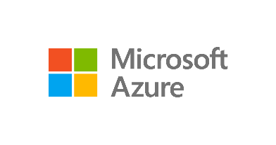

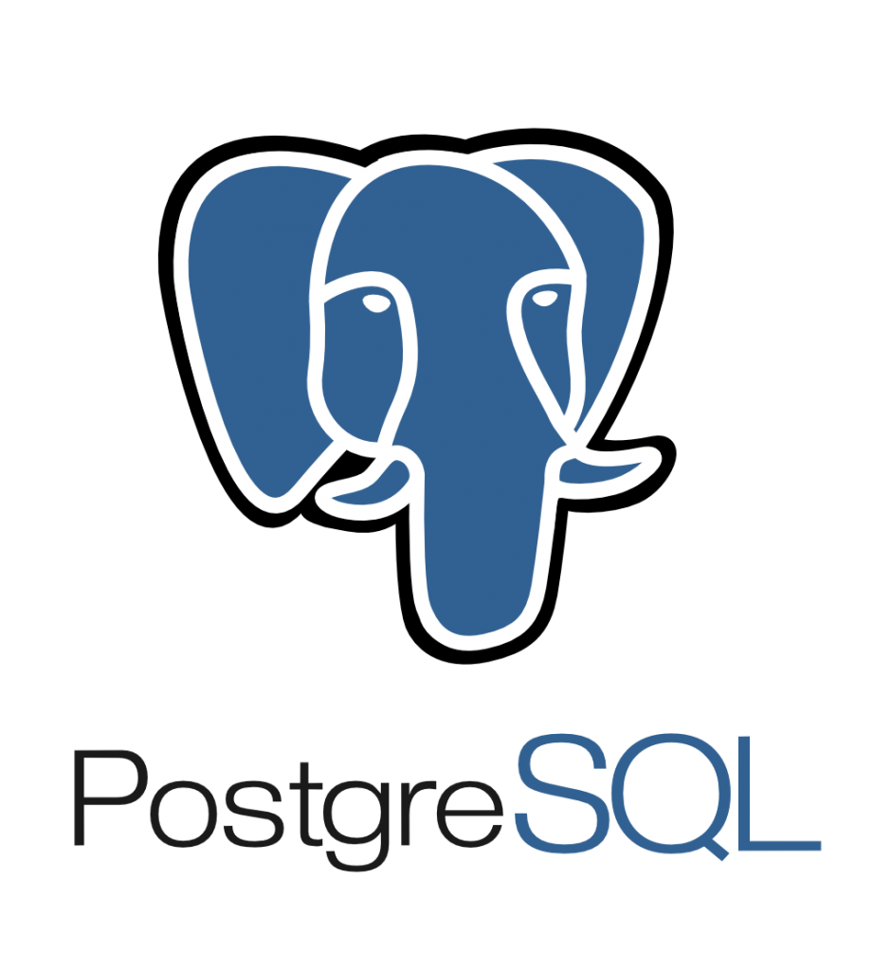


Migrating databases using Azure Database Migration Services
Seamless, end to end solution | Near-zero downtime | Resilient | Migrate at-scale from multiple sources
On-premises
SQL
SQL
Azure SQL Database
SQL Server 2005 - 2017
SQL Server on Azure VMs
Assessment
SSMA, DEA & DMA
Azure Database Migration Service
Cosmos DB
My
Azure Database for MySQL, PostgreSQL and MariaDB

Slide 107
What to remember when migrate
Latest driver versions provides best connectivity experience
MI is PaaS - build connectivity resilience into your code to protect from transient faults
Well-known SSMS tools supported – install latest version
MI is always on latest and greatest SQL engine version but supports db compat levels from 100 and above
Code can be MI aware, if necessary: SERVERPROPERTY (‘EngineEdition’) = 8
Current limitations (will be removed later this year)
Time is UTC . Use AT TIME ZONE to add local time zone experience
Instance collation is fixed (affects tempdb and system databases)
You can use read-only replicas to load balance read-only queries
Local and Geo-DR

Slide 108
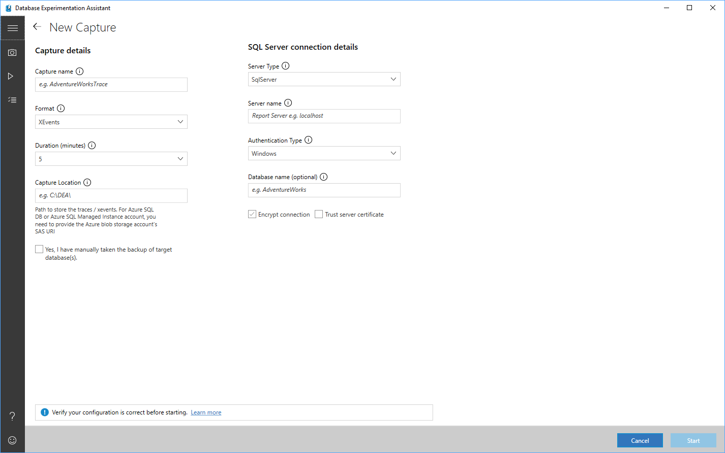
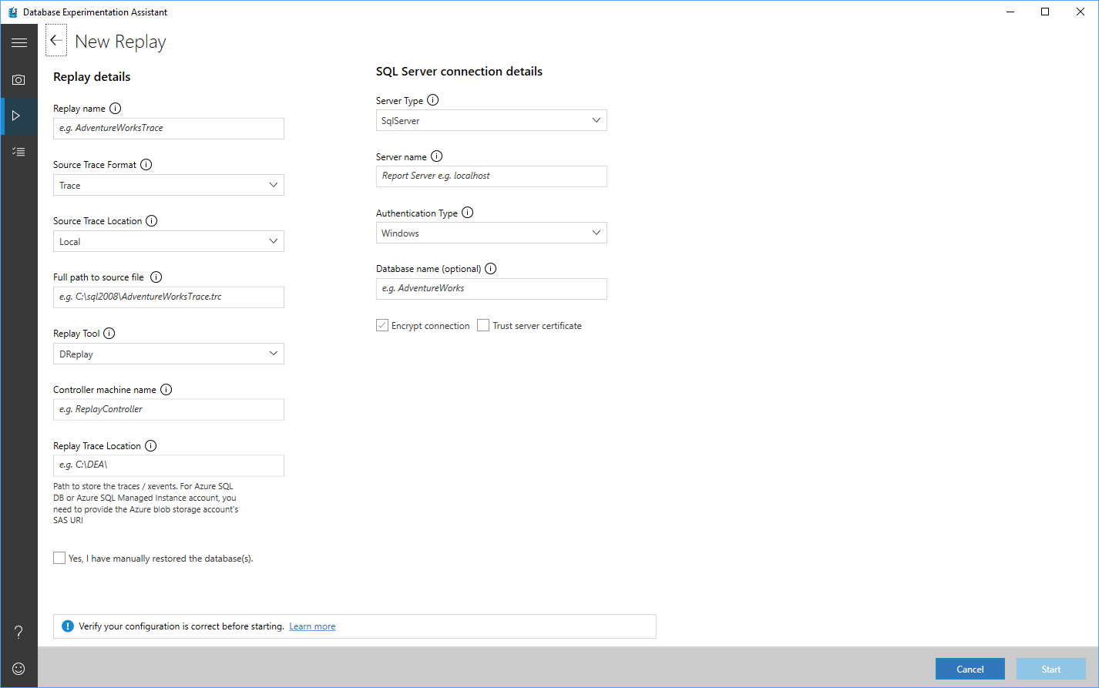
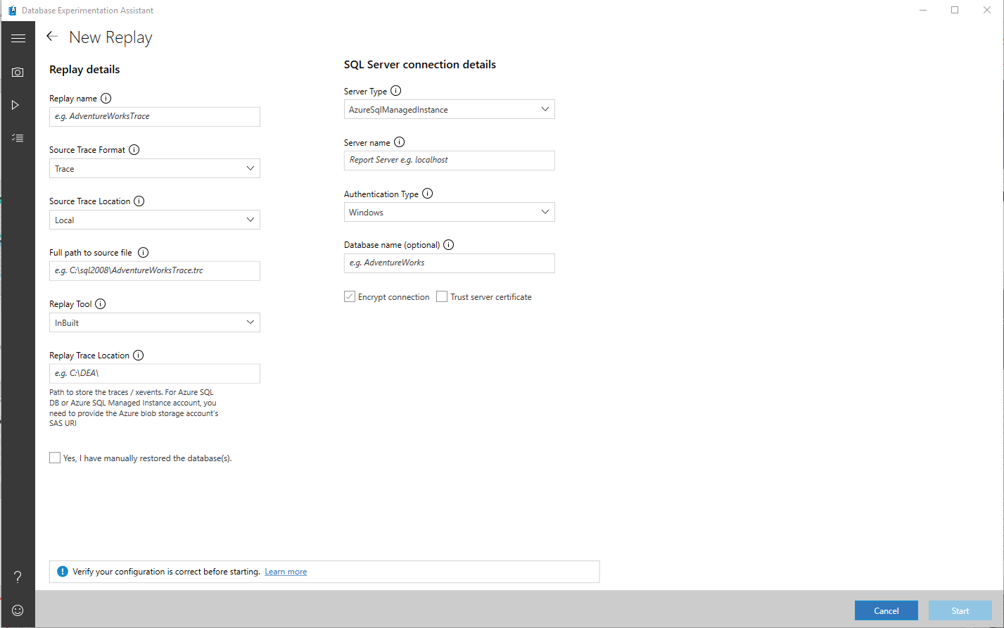
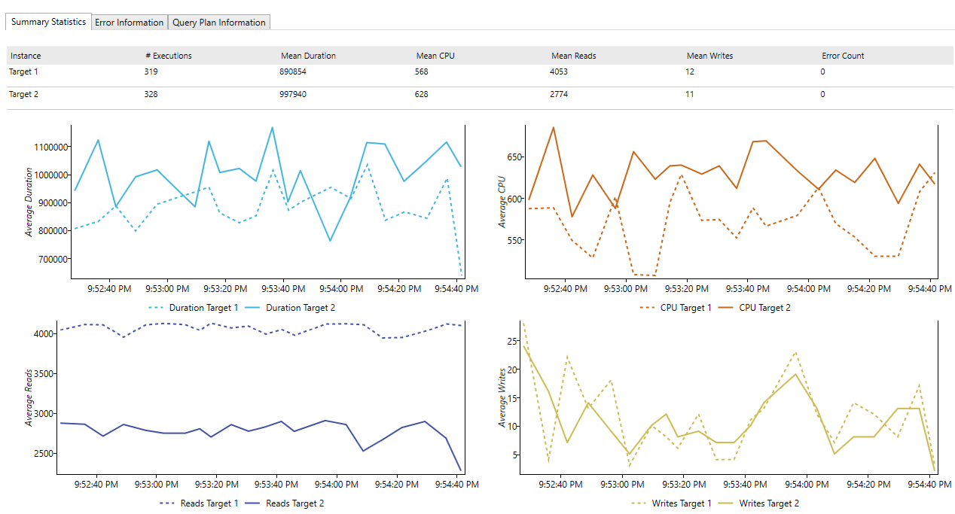
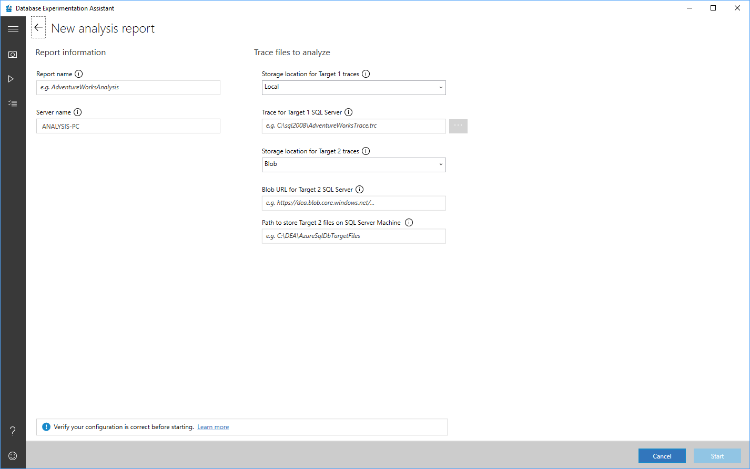
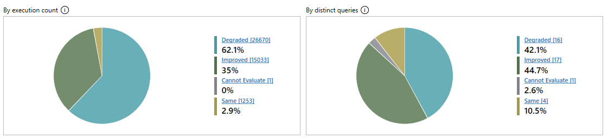
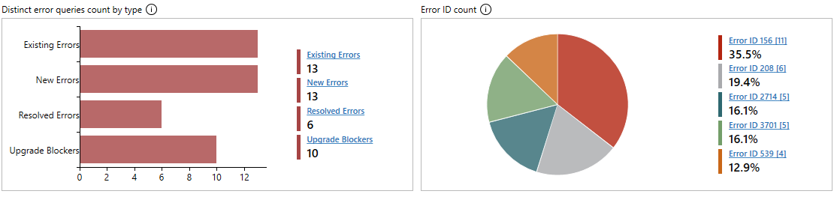
Database Experimentation Assistant
Notes:
Database Experimentation Assistant (DEA) is a new A/B testing solution for SQL Server upgrades.
It will assist in evaluating a targeted version of SQL for a given workload.
Customers who are upgrading from previous SQL Server versions (SQL Server 2005 and above) to any new version of the SQL Server will be able to use these analysis metrics.
https://www.microsoft.com/en-us/download/details.aspx?id=54090
https://blogs.msdn.microsoft.com/datamigration/2017/07/25/dea-2-1-general-availability-release-overview-database-experimentation-assistant/

Slide 109
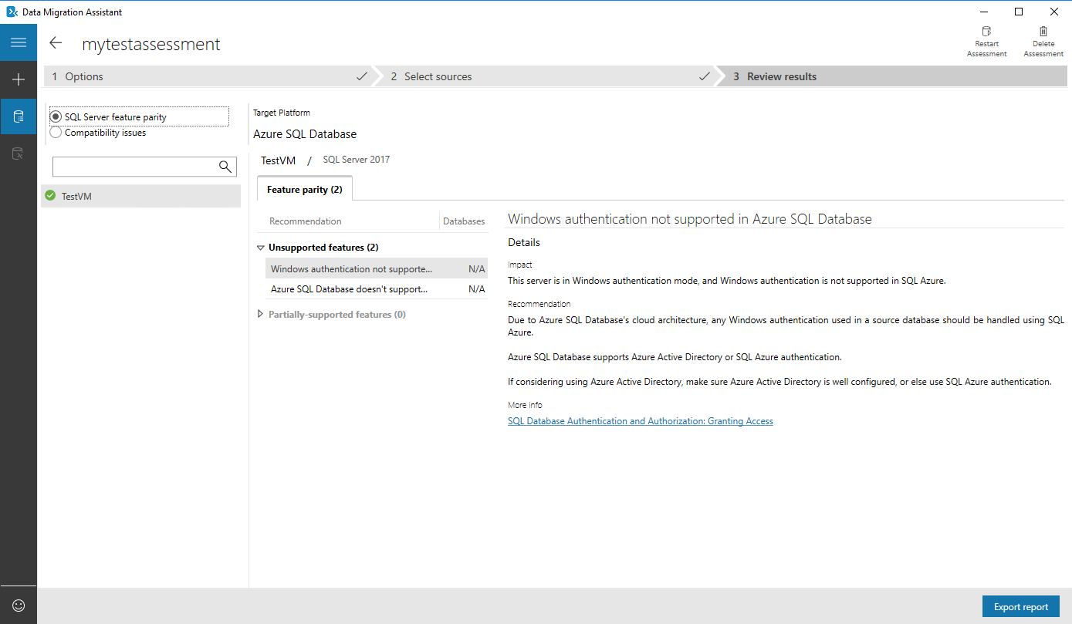
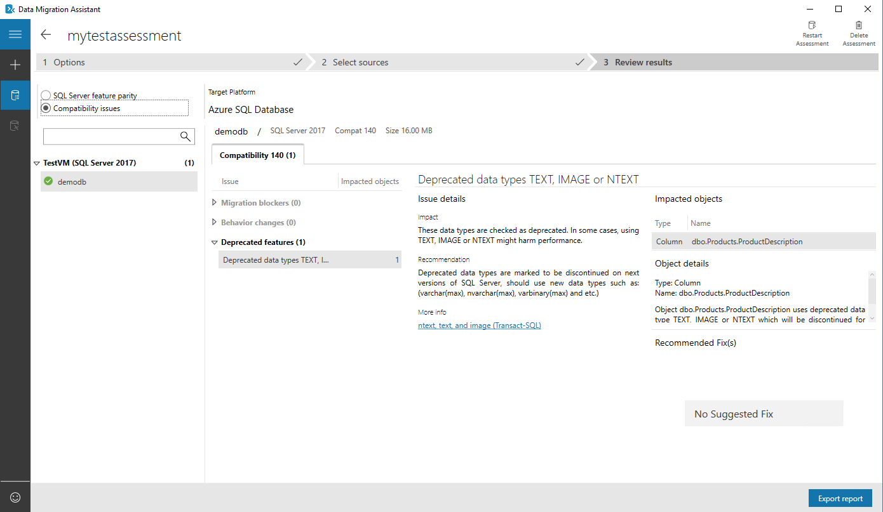
Data Migration Assistant
Assess on-premises SQL Server instance(s) for migrating to Azure SQL database(s)
Discover issues that can affect an upgrade
Migrate an on-premises SQL Server instance to a modern SQL Server instance
Notes:
Provides any recommendations and alternative approaches available in Azure prior to migrating
Categorized as performance, security, or storage
Identifies blocking issues: compatibility issues that block migrating on-premises SQL Server database(s) to Azure SQL Database(s)
Detects partially supported or unsupported features that are in use on the source SQL Server instance
Compatibility issues are categorized as breaking changes, behavior changes, or deprecated features
Can migrate databases schemas, data, users, logins, server roles

Slide 110
Demo Data Migration Assistant
Notes:
Run DMA assessment against AdventureWorks -> Azure SQL DB
Then run the assessment against AdventureWorks -> SQL MI

Slide 111
Azure Database Migration Service
Self-guided migration process
Provides comprehensive assessments for pre-migration
Allows for migration at scale from multiple sources to the target database with minimal downtime
Requires an active Azure subscription and site-to-site connectivity
Roadmap to support large amount of sources
Convergence of DMA functionality and DMS
Integration with Azure Databox

Slide 112
Migrate using Azure SQL Database Managed Instance This lab demonstrates how to migrate a SQL database to an Azure SQL Database Managed Instance using the Azure Database Migration Service.
HOL
Lab

Slide 113
Lab Migrate using Azure SQL Database Managed Instance ​ http://tinyurl.com/?????????
Notes:
The tinyurl for the instructor led labs/workshops will be emailed to the instructor after booking through the portal: https://www.microsoft.com/handsonlabs/instructorledlabs
Pre-book these for the # of people, date and location

Slide 114



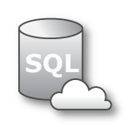


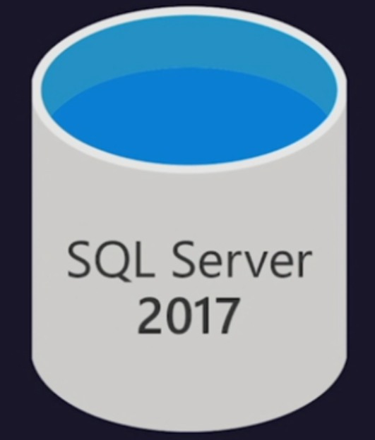


SQL -> SQL Database MI online migration workflow
Legend
Virtual Network ( VNET )
Full Database backup files
Subnet used for MI
Transaction log backup files
Site to site connectivity (VPN or ExpressRoute)
4
Azure Blob Storage
2
1
Provide existing backups in network share
Cloud network
SQL DB
Managed Instance
Subnet used for DMS
2
DMS upload backup files to Azure storage
3
3
DMS initiate the migration to Azure SQL MI
4
Full backup restored and Transaction log
backups continuously applied until cutover
1
SMB Network Share
Provide Tail-Log backup, initiate cutover in DMS and change the application connection strings
On-Premise

Slide 115
Resources
Azure Database Migration Service https://azure.microsoft.com/services/database-migration/
Preview signup: https://aka.ms/dms-preview
Feedback alias: dmsfeedback@microsoft.com
Channel 9 Video: Oracle migrations; Azure SQL Database migrations
Video: Online migrations to Azure SQL Database using Azure DMS
Video: Migrate MySQL applications to Azure with minimal downtime using the Azure Database Migration Service
Migration Guide datamigration.microsoft.com
SQL Server Migration Assistant: https://docs.microsoft.com/sql/ssma/sql-server-migration-assistant
Database Migration Assistant: https://blogs.msdn.microsoft.com/datamigration/dma/
Database Experimentation Assistant: Download
Find a partner: http://migration/Pages/SearchPartners.aspx
Data Migration Team Blog: blogs.msdn.microsoft.com/datamigration/

Slide 116
Agenda
Intro to Azure SQL Database
Value prop, Platform benefits, TCO
Managed Instance overview
Managed Instance overview and architecture, Hands-on-lab
Security & Networking
Security overview, Networking considerations, demos
Features and capabilities
Key capabilities, limitations, backup & restore
Replication & Monitoring
Replication and Monitoring, demo
Migration
Migration overview and options, Hands-on-Lab
ETL/ELT Services overview
Running SSIS in the cloud, Hands-on-Lab
Hyperscale
Working with large workloads, demo
Closing
Q&A, technical resources, etc.,

Slide 117











Comprehensive hybrid cloud for data analytics
Data loading
Data factory
Azure Import/Export Service
Azure Data Box
APIs, CLI, and GUI tools
On-premises data
Oracle, SQL, Teradata,
File shares, SAP
Ingest storage
Data processing
Serving storage
Predictive apps
Cloud data
Azure, AWS, GCP
Azure Databricks
Operational reports
Data Lake Store
Azure Storage
Cosmos DB
101010
010101
101010
HDInsight
Azure Data Lake Analytics
Azure SQL DW
Analytical dashboards
SaaS data
Salesforce, Workday,
Dynamics
Cosmos DB
SQL DB
AAS
Power BI
Operational data

Slide 118
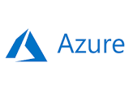

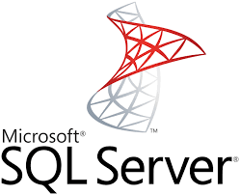
Migration to Azure
Managed Instance
SSIS in Azure Data Factory
Azure Analysis Services
Power BI
Replace / upload reports
Full compat
Tabular
Native restore of backups
Database Migration Service (near-zero-downtime)
Azure virtual machine
SQL Server engine
SSIS
SSAS
SSRS

Slide 119
Microsoft ETL/ELT Services
Running SSIS on-premises
OS: Windows/Linux
SCALABILITY: Scale-Out feature
EDITION: Standard/Enterprise
TOOLS: SSDT/SSMS to design/deploy/ manage/execute/monitor packages
EXTENSIBILITY: ISVs can build components/extensions on SSIS
PRICING: Bundled w/ on-prem SQL Server
On-premises
SQL
SSIS
Data sources
SQL Server
Notes:
SQL Server Integration Service is a component of SQL Server that is used for data migration tasks to Extract, Transform & Load (ETL) data. Also, Extract, Load & Transform (ELT) data.
The service is typically used for data integration and workflow applications.

Slide 120

Microsoft ETL/ELT Services
Running SSIS in the cloud
LIFT & SHIFT: Use Azure SQL DB/Managed Instance to host SSISDB
SCALABILITY: Use ADF to provision a managed cluster of Azure VMs dedicated to run your packages – Azure-SSIS Integration Runtime (IR)
EDITION: Standard/Enterprise
TOOLS: SSDT/SSMS + ADF app to design/deploy/manage/execute/monitor packages (activities)
EXTENSIBILITY: ISVs can build components/extensions + SaaS on SSIS in ADF via custom setup + 3rd party licensing
PRICING: Pay per hour + Azure Hybrid Benefit to Bring Your Own License (BYOL)
Azure Data Factory
SSIS Integration Runtime
SQL
Data sources
SSIS ETL
SQL Database
Managed Instance
Cloud
On-premises
SQL
SSIS
Data sources
SQL Server
Notes:
We start with SSIS and ADF as two separate tools for traditional on-prem ETL and modern cloud ELT workflows, respectively.
We are converging these tools to create a unified platform for Microsoft ETL/ELT services in the cloud.
Reference docs:
https://docs.microsoft.com/en-us/azure/data-factory/tutorial-deploy-ssis-packages-azure

Slide 121
Microsoft ETL/ELT Services
Running SSIS in the cloud
HYBRID: Join Azure-SSIS IR to a VNet that is connected to your on-prem network to enable on-prem data access
MODERNIZATION: Schedule first-class SSIS activities in ADF pipelines via SSMS and chain/group them w/ other activities via ADF app
COMPLEMENTARY: Splice/inject built-in/custom/Open Source/3rd party SSIS tasks and transformations in ADF pipelines
READINESS: General Availability (GA) w/ 24/7 live-site support
Azure Data Factory
SSIS Integration Runtime
SQL
Data sources
SSIS ETL
SQL Database
Managed Instance
Cloud
On-premises
VNET
SQL
SSIS
Data sources
SQL Server
Notes:
We start with SSIS and ADF as two separate tools for traditional on-prem ETL and modern cloud ELT workflows, respectively.
We are converging these tools to create a unified platform for Microsoft ETL/ELT services in the cloud.
Reference docs:
https://docs.microsoft.com/en-us/azure/data-factory/tutorial-deploy-ssis-packages-azure

Slide 122
SSIS IR Enterprise Edition
Enterprise Edition of Azure-SSIS IR allows you to use advanced/premium features
Change Data Capture (CDC) components
Oracle/Teradata/SAP BW connectors
SQL Server Analysis Services (SSAS)/Azure Analysis Services (AAS) connectors/transformations
Fuzzy Grouping/Lookup transformations
Term Extraction/Lookup transformations
Some of these features will also require you to install additional components, essentially customizing your Azure-SSIS IR (via Custom Setup Interface)
Notes:
Reference docs:
https://docs.microsoft.com/en-us/azure/data-factory/how-to-configure-azure-ssis-ir-custom-setup
https://docs.microsoft.com/en-us/azure/data-factory/how-to-configure-azure-ssis-ir-enterprise-edition

Slide 123
SSIS IR Custom setup interface
Custom setup allows you to add your own setup steps during the provisioning/reconfiguration of your Azure-SSIS IR to:
Alter the default operating configuration/environment (e.g. to start additional Windows services or persist access credentials for file shares)
Install additional components (e.g. APIs/assemblies/drivers/extensions)
Instructions
Prepare a script (main.cmd) + associated files and upload them into a blob container in your Azure Storage account
Provide Shared Access Signature (SAS) Uniform Resource Identifier (URI) of your container when you provision/reconfigure your Azure-SSIS IR
Each node of your Azure-SSIS IR will then download the script + files from your container and execute your custom setup with an elevated privilege
Upon completion, each node will upload the standard output of execution and other logs into your container
We support the installation of free/paid/(un)licensed components
Notes:
Reference docs:
https://docs.microsoft.com/en-us/azure/data-factory/how-to-configure-azure-ssis-ir-custom-setup
https://docs.microsoft.com/en-us/azure/data-factory/how-to-configure-azure-ssis-ir-enterprise-edition

Slide 124
3rd party licensing
To support the installation of paid/licensed components from our ISV partners, we face challenges from the nature of Azure-SSIS IR as the nodes are volatile in the sense that they can be allocated/released at any time
We regularly reimage the nodes to release security patches/new features
Customers can start/stop their Azure-SSIS IR to manage its running cost
Customers can scale up/down through various node sizes
Customers can scale in/out the number of nodes between 1 to 10 (or more by a special request)
Binding a component installation to any particular node by collecting machine-specific info that is traditionally used for on-prem installations, e.g. MAC address, CPU ID, etc. isn’t viable anymore
We provide new unique and persistent Windows environment + SSIS system variables for ISVs to bind/validate their component licenses on Azure-SSIS IR:
Cluster ID and Cluster Node Count
Notes:
Reference docs
https://docs.microsoft.com/en-us/azure/data-factory/how-to-develop-azure-ssis-ir-licensed-components

Slide 125

3rd Party Extensibility – How to
2. Get Activation Key by submitting Cluster ID + Product Key
Azure SSIS IR Node
ISV Activation Server
1. Specify Product Key in setup script
ISV Setup
2. Activation Key
3. Write Activation Key
Container
4. Report on node count (Optional)
SSIS Executor
Local Store
(E.g. Registry)
4. Read Activation Key and validate it with Cluster ID
ISV Extension
4. Get Cluster ID
SSIS Runtime
Setup
Runtime
Notes:
Reference docs
https://docs.microsoft.com/en-us/azure/data-factory/how-to-configure-azure-ssis-ir-custom-setup
https://docs.microsoft.com/en-us/azure/data-factory/how-to-develop-azure-ssis-ir-licensed-components

Slide 126








ISV Partners
SSIS Team Blog: https://blogs.msdn.microsoft.com/ssis/
https://blogs.msdn.microsoft.com/ssis/2018/04/27/enterprise-edition-custom-setup-and-3rd-party-extensibility-for-ssis-in-adf/
Notes:
Reference doc
https://blogs.msdn.microsoft.com/ssis/2018/04/27/enterprise-edition-custom-setup-and-3rd-party-extensibility-for-ssis-in-adf/

Slide 127
Documentation
Provisioning Azure-SSIS IR | Using UI: https://docs.microsoft.com/en-us/azure/data-factory/tutorial-deploy-ssis-packages-azure Using PSH: https://docs.microsoft.com/en-us/azure/data-factory/tutorial-deploy-ssis-packages-azure-powershell Using ARM template: https://docs.microsoft.com/en-us/azure/data-factory/create-azure-ssis-integration-runtime#azure-resource-manager-template
Provisioning Azure-SSIS IR using Azure SQL DB w/ VNet service endpoints/Managed Instance to host SSISDB | Using UI/PSH: https://docs.microsoft.com/en-us/azure/data-factory/create-azure-ssis-integration-runtime Joining a VNet: https://docs.microsoft.com/en-us/azure/data-factory/join-azure-ssis-integration-runtime-virtual-network
Provisioning Azure-SSIS IR using AAD Auth w/ the managed identity for ADF | Using UI/PSH: https://docs.microsoft.com/en-us/azure/data-factory/create-azure-ssis-integration-runtime Enabling AAD Auth: https://docs.microsoft.com/en-us/azure/data-factory/enable-aad-authentication-azure-ssis-ir
Provisioning Azure-SSIS IR inside a VNet to access data on premises | Using UI/PSH: https://docs.microsoft.com/en-us/azure/data-factory/create-azure-ssis-integration-runtime Joining a VNet: https://docs.microsoft.com/en-us/azure/data-factory/join-azure-ssis-integration-runtime-virtual-network
Monitoring Azure-SSIS IR | Using UI/PSH: https://docs.microsoft.com/en-us/azure/data-factory/monitor-integration-runtime#azure-ssis-integration-runtime

Slide 128
Documentation
Configuring Azure-SSIS IR | Using UI/PSH: https://docs.microsoft.com/en-us/azure/data-factory/manage-azure-ssis-integration-runtime
Configuring Azure-SSIS IR to use Enterprise Edition | Using UI/PSH: https://docs.microsoft.com/en-us/azure/data-factory/how-to-configure-azure-ssis-ir-enterprise-edition
Configuring Azure-SSIS IR to use custom setup | Using UI/PSH: https://docs.microsoft.com/en-us/azure/data-factory/how-to-configure-azure-ssis-ir-custom-setup
Configuring Azure-SSIS IR for high performance | Using UI/PSH: https://docs.microsoft.com/en-us/azure/data-factory/configure-azure-ssis-integration-runtime-performance
Configuring Azure-SSIS IR for disaster recovery | Using UI/PSH: https://docs.microsoft.com/en-us/azure/data-factory/configure-bcdr-azure-ssis-integration-runtime
Deploying projects/packages to run on Azure-SSIS IR | Using UI/PSH: https://docs.microsoft.com/en-us/sql/integration-services/lift-shift/ssis-azure-deploy-run-monitor-tutorial?view=sql-server-2017 Connecting SSMS to SSISDB: https://docs.microsoft.com/en-us/sql/integration-services/lift-shift/ssis-azure-connect-to-catalog-database?view=sql-server-2017 Validating projects/packages: https://docs.microsoft.com/en-us/sql/integration-services/lift-shift/ssis-azure-validate-packages?view=sql-server-2017

Slide 129
Documentation
Connecting to data sources using Win Auth on Azure-SSIS IR | Using 3 methods: https://docs.microsoft.com/en-us/sql/integration-services/lift-shift/ssis-azure-connect-with-windows-auth?view=sql-server-2017
Connecting to file shares and processing files on Azure-SSIS IR | Using local file system/file shares: https://docs.microsoft.com/en-us/sql/integration-services/lift-shift/ssis-azure-files-file-shares?view=sql-server-2017 Using Win Auth: https://docs.microsoft.com/en-us/sql/integration-services/lift-shift/ssis-azure-connect-with-windows-auth?view=sql-server-2017
Running packages on Azure-SSIS IR | Using SSMS/ADF/other methods: https://docs.microsoft.com/en-us/sql/integration-services/lift-shift/ssis-azure-run-packages?view=sql-server-2017 As Execute SSIS Package activities in ADF pipelines: https://docs.microsoft.com/en-us/azure/data-factory/how-to-invoke-ssis-package-ssis-activity As Stored Procedure activities in ADF pipelines: https://docs.microsoft.com/en-us/azure/data-factory/how-to-invoke-ssis-package-stored-procedure-activity
Scheduling package executions on Azure-SSIS IR | Using SSMS/ADF/other methods: https://docs.microsoft.com/en-us/sql/integration-services/lift-shift/ssis-azure-schedule-packages?view=sql-server-2017 Using SSMS: https://docs.microsoft.com/en-us/sql/integration-services/lift-shift/ssis-azure-schedule-packages-ssms?view=sql-server-2017 As Execute SSIS Package activities in ADF pipelines: https://docs.microsoft.com/en-us/azure/data-factory/how-to-invoke-ssis-package-ssis-activity As Stored Procedure activities in ADF pipelines: https://docs.microsoft.com/en-us/azure/data-factory/how-to-invoke-ssis-package-stored-procedure-activity

Slide 130
Documentation
Scheduling Azure-SSIS IR provisioning on demand/just in time | Using Azure Automation: https://docs.microsoft.com/en-us/azure/data-factory/how-to-schedule-azure-ssis-integration-runtime
Cleaning up package execution logs in SSISDB | Using Elastic Jobs: https://docs.microsoft.com/en-us/azure/data-factory/how-to-clean-up-ssisdb-logs-with-elastic-jobs
Developing premium/licensed components for Azure-SSIS IR | Using Cluster ID: https://docs.microsoft.com/en-us/azure/data-factory/how-to-develop-azure-ssis-ir-licensed-components
Procuring 3rd party components for Azure-SSIS IR | Partner list: https://blogs.msdn.microsoft.com/ssis/2018/04/27/enterprise-edition-custom-setup-and-3rd-party-extensibility-for-ssis-in-adf/

Slide 131
Business Intelligence Services
Recommendation:
Move BI solutions to PaaS model
Power BI
Not installed side-by-side with Managed Instance
Migrate your SSIS packages to new SSIS on Azure Data Factory (PaaS service)
Migrate your OLAP models to Azure Analysis Services
… or run these services in Azure virtual machines
For SSRS: run in a virtual machine, or switch to Power BI
SSIS / SSAS PaaS
SQL
SQL Server Reporting Services
SSIS/SSAS
Notes:
SQL Database Managed Instance reduces the differences between on-premise SQL Server and a fully managed database service, so that the migration becomes much easier.
SQL Database Managed Instance offers a simplified instance-scoped programming model that is like an on-premises SQL Server instance. The databases in Managed Instance share the resources allocated to the Managed Instance, and the Managed Instance also represents the management grouping for these databases. The emphasis of this offering is on high compatibility with the programming model of on-premises SQL Server and out-of-box support for the large majority of SQL Server features and accompanying tools/services.

Slide 132
Lift your SQL server integration services (SSIS) packages to azure
Azure Data Factory
SSIS Integration Runtime
SQL
Data sources
SSIS ETL
SQL Database
Managed Instance
Cloud
On-premises
VNET
SQL
SSIS ETL
Data sources
SQL Server
Notes:
Easily execute and schedule your SQL Server Integration Services (SSIS) packages in managed execution environment for SSIS in Azure Data Factory version 2 (ADF v2)
Gain high availability, scalability and lower TCO by lifting your SSIS packages to Azure
Continue to build, monitor and manage packages with existing tools like SQL Server Management Studio (SSMS) & SQL Server Data Tools (SSDT)
You can install both free or unlicensed components, and paid or licensed components!
Learn more: https://docs.microsoft.com/en-gb/azure/data-factory/tutorial-deploy-ssis-packages-azure

Slide 133
SQL Managed Instance data integration and business intelligence Learn to control the seamless orchestration of your enterprises' data integration efforts through an extensive tour of Azure Data Factory.
HOL
Lab

Slide 134
Lab SQL Managed Instance data integration and business intelligence http://tinyurl.com/????????
Notes:
The tinyurl for the instructor led labs/workshops will be emailed to the instructor after booking through the portal: https://www.microsoft.com/handsonlabs/instructorledlabs
Pre-book these for the # of people, date and location

Slide 135
Agenda
Intro to Azure SQL Database
Value prop, Platform benefits, TCO
Managed Instance overview
Managed Instance overview and architecture, Hands-on-lab
Security & Networking
Security overview, Networking considerations, demos
Features and capabilities
Key capabilities, limitations, backup & restore
Replication & Monitoring
Replication and Monitoring, demo
Migration
Migration overview and options, Hands-on-Lab
ETL/ELT Services overview
Running SSIS in the cloud, Hands-on-Lab
Hyperscale
Working with large workloads, demo
Closing
Q&A, technical resources, etc.,

Slide 136
Challenges with managing Very Large Databases (VLDB)
Size of data
Scaling Compute
Operations take a LONG time (days in some cases)
Ongoing operations degrade database performance
Can cause outages and downtime
Provisioning more storage to expand the database can be painful
Logistics of moving to larger box
Economics of sizing for max peaks
Notes:
Anything that requires size-of-data operations is a big problem
Operations (for example, restore) take a LONG time (days in some cases)
Ongoing operations degrade database performance
Can cause outages and downtime
Provisioning more storage to expand the database can be painful
Scaling compute power can be challenging
Logistics of moving to larger box
Economics of sizing for max peaks

Slide 137
What is Hyperscale?
Hyperscale is a new, highly scalable service tier that adapts on-demand to your workload's needs, auto-scaling up to 100TB per database.
Storage dynamically adapts to your workloads’ needs, auto-scaling up to 100TB.
Provision one or more additional compute nodes that can serve your read-only workload and use them as a hot-standby, in case of failover.
Perform operations in constant time, regardless of the size of the data operation.
Compute and storage resources scale rapidly and independently without sacrificing performance.
100
TB
9
TB
Notes:
Hyperscale is an all new storage layer under the database
Hyperscale is architected for the cloud from the ground up
Hyperscale is fully compatible with Azure SQL Database
Hyperscale is no limits
Hyperscale is VLDB size without the VLDB headaches
Support for 100TB+

Slide 138

Azure SQL Database Hyperscale
Adapts on-demand to your workload's needs, auto-scaling up to 100TB per database.
100
TB
Reliable and available
Scalable
High performance
Multiple levels of redundancy
No single points of failure
99.99% availability
Auto-scales quickly up to 100TB
Data size and cores scale independently
No size of data operations
Low latency, high throughput for large databases
Snapshot-based backups – no impact on query performance
Rapid database restore
Best for VLDB workloads with highly scalable storage and read-scale requirements, optimized for OLTP and HTAP workloads.
Notes:
The Hyperscale service tier is a highly scalable performance tier that leverages the Azure architecture to scale out resources for SQL Database substantially beyond the limits available for the General Purpose and Business Critical service tiers.
Hyperscale provides the following additional capabilities:
Reliable and available
Because it’s part of SQL Database, it has multiple levels of redundancy and no single points of failure. It also provides a 99.99% availability SLA.
Scalable
Support for up to 100 TB of database size
Compute and storage scale independently
Nearly instantaneous database backups (based on file snapshots stored in Azure Blob storage) regardless of size with no IO impact on Compute
High performance
Fast database restores (based on file snapshots) in minutes rather than hours or days (not a size of data operation)
Higher overall performance due to higher log throughput and faster transaction commit times regardless of data volumes
Rapid Scale up - you can, in constant time, scale up your compute resources to accommodate heavy workloads when needed, and then scale the resources back down when not needed.
Rapid scale out - you can provision one or more read-only nodes for offloading your read workload and for use as hot-standbys

Slide 139
Committed to choice
What is a virtual core (vCore)?
Choose from three vCore-based service tiers
 | General purpose | Hyperscale | Business critical
Best for | Most budget-oriented workloads | VLDB OLTP and HTAP workloads with highly scalable storage and read-scale requirements | Critical business applications with high IO requirements.
Compute tiers | Gen4: 1 to 24 vCore Gen5: 2 to 80 vCore
Storage | Premium remote 32GB – 8TB per instance | Local SSD Auto-scale up to 100TB of storage | Local SSD 32GB – 4TB per instance
HA | 2 read replicas | Primary read/write replica + up to 4 read replicas | 3 replicas, 1 read-scale replica, zone-redundant HA
In-Memory | Not supported | Not supported | Supported
Read-write IO | Low | Medium | High
Flexible, transparent, independently-defined resource options
Representation of compute power in the cloud via the logical CPU available for your server
Configure compute and storage independently
Enables right-sizing the destination environment by translating on-premises requirements
Best if you value flexibility, control and transparency
Notes:
Simple and flexible
You choose the right resource management approach for you.
The DTU-based model is based on a bundled measure of compute, storage, and IO resources. Compute sizes are expressed in terms of Database Transaction Units (DTUs) for single databases and elastic Database Transaction Units (eDTUs) for elastic pools. It is generally best for customers who want simple, pre-configured resource options.
The vCore-based model allows you to independently choose compute and storage resources and is best for customers who value flexibility, control, and transparency.
Both the DTU-based and vCore-based models are available to SQL databases and elastic pools. The DTU-based model is not available in the Managed Instance option.
The vCore model simplifies the hybrid benefit for your migration from on-premises, reflecting Microsoft’s commitment to customer choice. It includes three storage architectures, each one differentiated by the level of HA and storage performance required by your workload. Pricing is based upon the number of vCores and storage and whether the license is included or if you’re using the Azure Hybrid Benefit for SQL Server to maximize your on-premises license investment.
There are three options to choose from:
General Purpose: great for most business workloads, offering budget-oriented, balanced and scalable compute and storage options.
Hyperscale: best for data applications with large data capacity requirements and the ability to auto-scale storage and scale compute fluidly. (Hyperscale is currently in preview and available for single databases only at this time.)
Business Critical: great for business applications that have high IO requirements, delivering the highest resilience to failures using 3 isolated Always On replicas with one read-scale.

Slide 140
Hyperscale is available for single databases
Azure SQL Database
Single
Elastic Pool
Managed Instance
Database-scoped deployment option with predictable workload performance
Shared resource model optimized for greater efficiency of multi-tenant applications
Instance-scoped deployment option with high compatibility with SQL Server and full PaaS benefits
Best for apps that require resource guarantee at database level
Best for SaaS apps with multiple databases that can share resources at database level, achieving better cost efficiency
Best for modernization at scale with low friction and effort
General Purpose
Business Critical
Hyperscale
Notes:
There are three hosting options available in Azure SQL Database:
Single database, assigning a certain amount of resources via performance tiers and focusing on a simplified database-scoped programming model and applications with a predictable pattern and relatively stable workload.
Elastic database pool is a shared resource model that enables higher resource utilization efficiency, with all databases within an elastic pool sharing predefined resources. This option focuses on a simplified database-scoped programming model for multi-tenant SaaS apps. The workload pattern is well-defined and is highly cost-effective in multi-tenant scenarios. For ISVs with SaaS apps, the savings can be significant, in the hundreds of thousands of dollars or more.
Managed Instance [click to next slide]

Slide 141
Hyperscale your database
A new, highly scalable service tier that adapts on-demand to your workload's needs, auto-scaling up to 100TB per database.
Storage dynamically adapts to your workloads’ needs, auto-scaling up to 100TB.
Provision one or more additional compute nodes that can serve your read-only workload and use them as a hot-standby, in case of failover.
Perform operations in constant time, regardless of the size of the data operation.
Compute and storage resources scale rapidly and independently without sacrificing performance.
SQL Database Hyperscale
Read and write
Read only
Primary Compute
Secondary Compute
Secondary Compute
Secondary Compute
RBPEX data cache
RBPEX data cache
RBPEX data cache
RBPEX data cache
Compute
Landing Zone
(Azure Premium Storage)
Log service
Storage
Log cache
1 TB data file
1 TB data file
1 TB data file
Log destaging
Covering RBPEX data cache
Covering RBPEX data cache
…
Covering RBPEX data cache
Long-term log storage for PITR (Azure Standard storage)
Legend:
Data pages
Data pages
…
Data pages
Local SSD cache
RBPEX: Resilient Buffer Pool Extension
File snapshots
File snapshots
File snapshots
Log pathway
Data pathway
Azure Storage
Notes:
Azure SQL Database Hyperscale is a new, highly scalable service tier that adapts on-demand to your customers’ workload's needs, quickly auto-scaling up to 100TB per database, eliminating the need to pre-provision storage resources and significantly expanding the potential for app growth without being limited by storage size. This new service tier also provides the ability to scale compute and storage resources independently, giving them the flexibility to optimize performance for their workloads. Azure SQL Database Hyperscale will initially be available for single database resource types.
NOTE: If a customer is mostly running interactive analytics queries and using SQL Server as a data warehouse today, Hyperscale can be an option. It allow customers to host a relatively small data warehouse (few TB to 10s of TB) with lower cost and migrate their data warehouse workload with no T-SQL code change. If a customer is running data analytics at large scale with complex queries, and using PDW, Teradata or other MPP data warehouses today, SQL Data Warehouse might be a better choice.
Hyperscale is currently in preview and initially available for single databases in the following regions, with more regions added over time: West US1, West US2, East US1, Central US, West Europe, North Europe, UK West, SouthEast Asia, Japan East, Korea Central, Australia SouthEast, Australia East

Slide 142
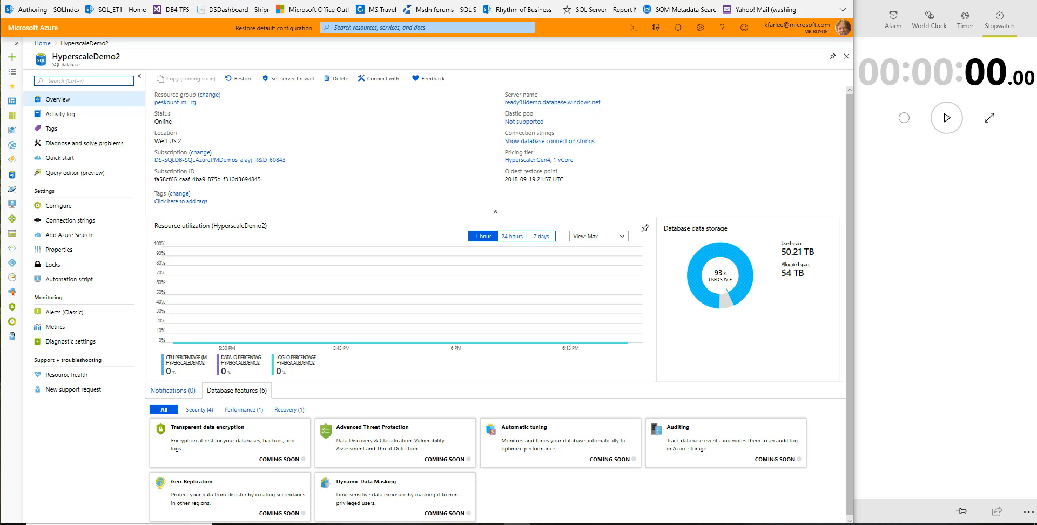

Slide 143
Agenda
Intro to Azure SQL Database
Value prop, Platform benefits, TCO
Managed Instance overview
Managed Instance overview and architecture, Hands-on-lab
Security & Networking
Security overview, Networking considerations, demos
Features and capabilities
Key capabilities, limitations, backup & restore
Replication & Monitoring
Replication and Monitoring, demo
Migration
Migration overview and options, Hands-on-Lab
ETL/ELT Services overview
Running SSIS in the cloud, Hands-on-Lab
Hyperscale
Working with large workloads, demo
Closing
Q&A, technical resources, etc.,

Slide 144
Documentation
Document | When to use it
What is a Managed Instance | High level details about SQL MI – service description and positioning
Azure SQL Database pricing page | Business model and pricing details
Azure Hybrid Use Benefit (AHUB) | Discount details for customers with SQL Server licenses
Feature comparison: Azure SQL Database versus SQL Server | High level feature availability matrix and need comparison with SQL Server and rest of SQL Database
Azure SQL Database Managed Instance T-SQL differences from SQL Server | Detailed functional behavior of SQL MI
Create Managed Instance - Tutorial | How to create SQL MI and connect to it (quick getting started guide)
How To: Configure a VNet for Azure SQL Database Managed Instance | How to makes sure that VNet is compliant with SQL MI requirements
How To: Configure a Custom DNS for Azure SQL Database Managed Instance | Networking misconfiguration is currently the most frequent reason that prevents customers from deploying SQL MI successfully
Connect your application to Azure SQL Database | High level of detail how to connect app to MI (supported scenarios, high level steps, links on detailed how-to)
SQL Server instance migration to Azure SQL Database Managed Instance | Various options to migrate application to SQL MI
https://docs.microsoft.com/en-us/azure/sql-database/sql-database-managed-instance-resource-limits | Subscription-level quotas and official process to obtain larger quota
Azure Support plans | Explore the range of Azure support options and choose the plan that best fits, whether you're a developer just starting your cloud journey or a large org. deploying business-critical, strategic applications
How to create Azure support request | Step by step instructions to open support ticket

Slide 145
Blogs, best practices
Document | When to use it
Managed Instance ARM template reference Create SQL MI using ARM templates Change size of SQL MI using PowerShell | SQL MI management through ARM templates & PowerShell (official docs and blogs)
Cross-instance point-in-time restore in Azure SQL Database Managed Instance | How to restore database to another instance
CAT Blog: CPU and Memory Allocation on Azure SQL Database Managed Instance | Explains how to interpret various information exposed in SSMS and DMVs regarding resource allocation is SQL MI
CAT Blog: Storage best practices in General Purpose | In this article, we describe database storage architecture on Azure SQL Database Managed Instance (MI), for General Purpose (GP) instances specifically. We also provide a set of best practices to help optimize storage performance
CAT Blog: Consume SQL MI Error Log | How to filter out unnecessary info from SQL error log and focus on what's important to your app using sp_readmierrorlog
CAT Blog: Real time performance monitoring for Azure SQL DB Managed Instance | Configuring and suing Telegraf for real-time perf. monitoring in SQL Managed Instance
BLOG: How to send emails in SQL MI using DbMail
SCOM Management Pack for SQL MI | The blog announcement for SCOM MP for SQL MI and scope details

Slide 146
Learn more about Azure SQL Database in the Azure blog
Read about the Database Migration Service announcement
Download the Migration Cookbook
Documentation for Azure SQL Database Managed Instance
https://aka.ms/sqlmidocs

